Slide 1
Getting on Track for 2020
Recommendations for Greenhouse Gas Regulations in Canada’s Oil and Gas Sector
Clare Demerse
April 2, 2013
Media Briefing

Slide 2
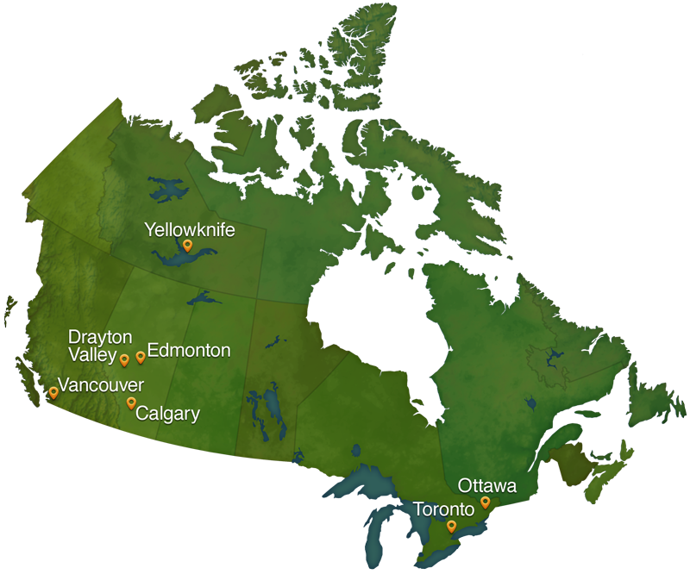
Leading Canada’s transition to a clean energy future
The Pembina Institute is a national non-profit think tank that advances clean energy solutions through research, education, consulting and advocacy.

Slide 3
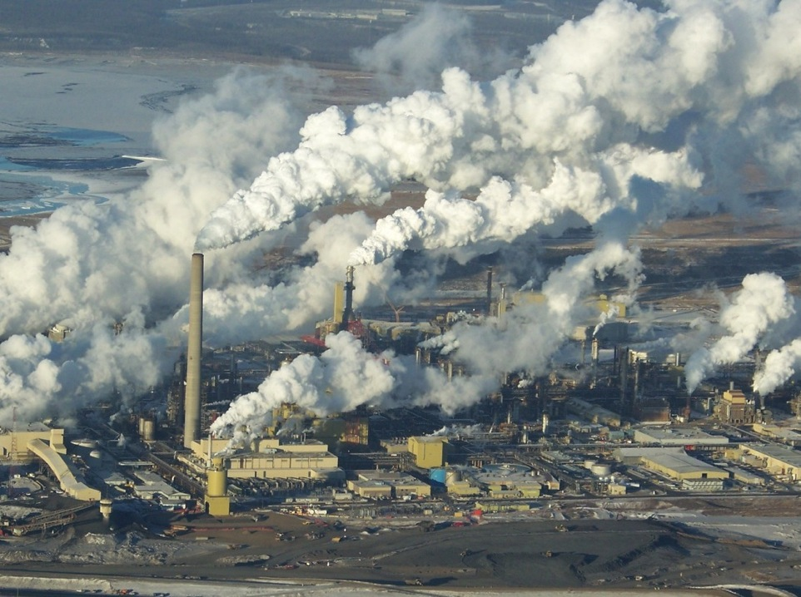
Context

Slide 4
General Context
Growing recognition in Canada that better environmental policies would help Canada’s oil and gas sector with some of the challenges it faces:
Securing public support (“social license”) for its operations
Maintaining access to markets where environmental performance matters (U.S., EU)
e.g. Premier Redford in USA Today: prepared “to push the bar higher in addressing climate change”
Notes:
Redford USA Today op-ed: http://www.usatoday.com/story/opinion/2013/02/25/keystone-pipeline-alberta-column/1943029/

Slide 5
Federal Commitments
2010: Canada adopts a new (and weaker) national greenhouse gas target for the year 2020. It’s the same as the U.S. 2020 target
Government has rejected broad-based carbon pricing in favour of a “sector by sector” approach
Regulations for vehicles (passenger and freight) and coal power have been adopted under this approach
2011: the government commits to regulating oil and gas emissions

Slide 6
Developing the Regulations
Environment Canada has been working on the oil and gas regulations since 2011
Convened a “Process Working Group” of oil and gas industry and the Government of Alberta
Environment Minister Peter Kent said in March that “we are in the final stages now of setting the stringency levels and I would hope that certainly by mid-year we would be in a position to share those.”

Slide 7
Canada's GHG emissions, 2010
Notes:
In 2010, oilsands were 31% of total Oil & Gas emissions (48 Mt of 154 Mt total)
Canada’s total 2010 emissions: 692 Mt

Slide 8
Canada's GHG emissions, 2020 (projected under current policy)
Notes:
…by 2020, oilsands are projected to grow to account for 51% of total oil & gas emissions (104 of 204 Mt)
Canada’s projected 2020 emissions under current policy: 720 Mt

Slide 9
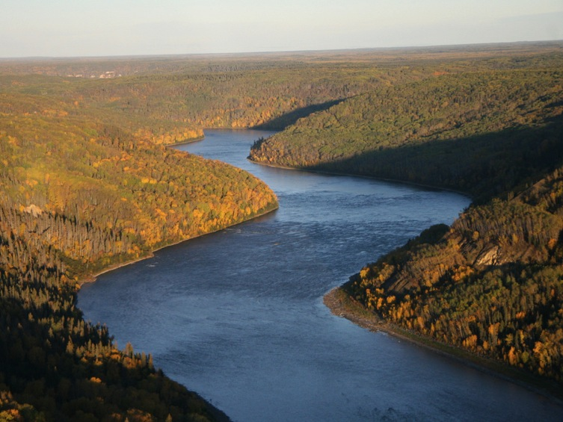
Getting on Track

Slide 10
The Benefits of Effective Regulations
Reducing GHG pollution helps tackle climate change, which is good for Canadians and the world
Strong regulations would also help the oil and gas industry by:
Providing more certainty about the “rules of the game” to companies making long-term decisions
Creating an incentive to innovate and improve efficiency
Increasing public support (“social license”) for the sector’s operations

Slide 11
“Sector by Sector” Regulations
The recommendations in our report conform to the Harper government’s approach of adopting “sector by sector” regulations
However, our preferred approach remains an economy-wide price on carbon, which is:
More economically efficient
Simpler to design and administer
Easier to ratchet up as needed to achieve the policy’s environmental goals

Slide 12
Getting on Track to 2020
Our starting point was “what does the oil and gas sector have to deliver to get Canada on track to its national GHG target for 2020?”
Many analyses show that Canada should take more ambitious action to deliver its fair share of the global effort to keep global warming below 2˚C
But right now, Canada is very far from being on track to hit its current 2020 target

Slide 13
Where we are today
Notes:
Source: http://www.ec.gc.ca/dd-sd/default.asp?lang=En&n=AD1B22FD-1
Canada’s 2020 target is 607 Mt or 17% below the 2005 emission level; the US is also committed to 17% below the 2005 emission level in 2020. (The Government of Canada no longer talks about a specific 2050 target.)
The purple line (720 Mt in 2020) is the trajectory Environment Canada projects after including all federal and provincial policies enacted to date (federal coal regulations, federal transportation regulations on passenger vehicles and freight, BC carbon tax, Ontario coal phase-out, Alberta’s GHG regs, etc) and 25 Mt of credits anticipated from new international forestry accounting rules

Slide 14
“Halfway there”?
There is a 113 million tonne (Mt) gap between Canada’s trajectory and hitting the target.
113 Mt is more than:
The current emissions from the provinces of Saskatchewan, Manitoba and New Brunswick combined (112 Mt in 2010)
All emissions from the electricity sector in Canada (101 Mt in 2010)
The current emissions from every Canadian passenger car, truck and bus put together (96 Mt in 2010)
Notes:
Canada’s full National Inventory Report for 2012 (the most recent currently available) is available at http://unfccc.int/national_reports/annex_i_ghg_inventories/national_inventories_submissions/items/6598.php
Because of a two-year lag in gathering GHG data, it provides emissions information for 2010.

Slide 15
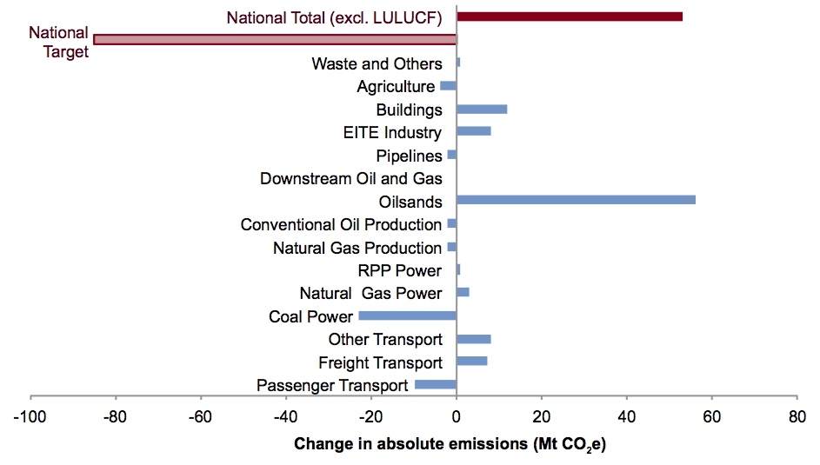
Notes:
Image from http://www.pembina.org/blog/668, source of data is Canada’s Emissions Trends 2012 (http://www.ec.gc.ca/Publications/default.asp?lang=En&n=3CD345DC-1)
From 2010 to 2020, oilsands emissions are projected to grow by 56 Mt, from 48 to 104 Mt.
Without the oilsands, emissions from the rest of the oil and gas sector in Canada are projected to drop by 6 Mt from 2010 to 2020. With the oilsands, oil and gas emissions are projected to grow by 50 Mt from 2010 to 2020.
With the oilsands, Canada’s emissions are projected to grow by 28 Mt from 2010 to 2020 (from 692 Mt to 720 Mt). Without the oilsands, Canada’s emissions would be projected to drop by 4 Mt from 2010 to 2020.
(Note that this assessment excludes emissions from the Land Use, Land Use Change and Forestry category, which are a new addition to Canada’s official emissions accounting in 2012 that will likely be adjusted over time. It also excludes emissions from liquified natural gas export, which may increase substantially if new facilities are built in British Columbia.)

Slide 16
The Size of the Gap
The federal government has already announced regulations for transportation and coal power
The 113 Mt gap already accounts for those policies AND for all existing carbon pricing / significant climate policies adopted by provincial governments
Oil and gas (22% of Canada’s total) is the biggest remaining sector and thus needs to close most of that gap

Slide 17
Closing the Gap
Canada could feasibly get on track to hit its target if the oil and gas sector closed ¾ of the gap (86 Mt of a 113 Mt gap)
That means limiting the sector’s total emissions to 42% below what they’re projected to be in 2020
Under current policies, the sector’s emissions are projected to reach 204 Mt in 2020
To get Canada on track, oil and gas emissions need to be limited to 118 Mt in 2020

Slide 18
Closing the Gap: the Role of Oil and Gas

Slide 19
Closing the Gap: A Different Trajectory for Oil and Gas Emissions

Slide 20
Implications of Closing the Gap
If oil and gas production grows as forecast, the emission level we recommend would mean a 42% improvement in the sector’s emissions intensity (i.e. emissions per barrel of oil produced)
That would more than halve the gap between the proposed values for oilsands and conventional crudes under the European Union and California clean fuels policies
But because Ottawa’s approach will likely give companies access to “flexible” ways to meet the regulation, some of the emission reductions will likely come from outside the oil and gas sector
Notes:
As per Slides 26 and 30, not all investments in flexible compliance options lead to actual emission reductions

Slide 21
Is the target realistic?
Might sound ambitious now, but it’s actually very similar to the government’s 2007-2008 Turning the Corner proposal, which was projected to reduce oil and gas emissions by 37% (83 Mt below projected 2020 level)
Our recommendations: 42% reduction (86 Mt below projected 2020 level)
Notes:
Turning the Corner also projected a 55% reduction in emissions from the oilsands sector (relative to business as usual in 2020)

Slide 22
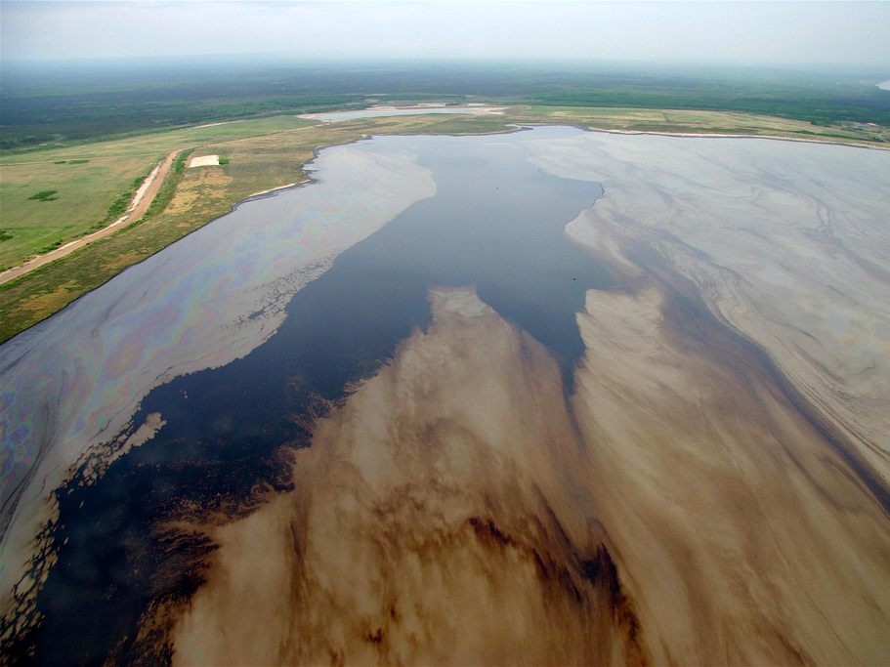
Applying Alberta’s Model

Slide 23
Alberta’s Model
We understand that the federal government is looking closely at Alberta’s system as a model for its rules
In Alberta’s GHG regulation, three parameters determine the environmental outcome: intensity target, technology fund price, and access to offsets
The weakest of the three effectively caps the system’s stringency

Slide 24
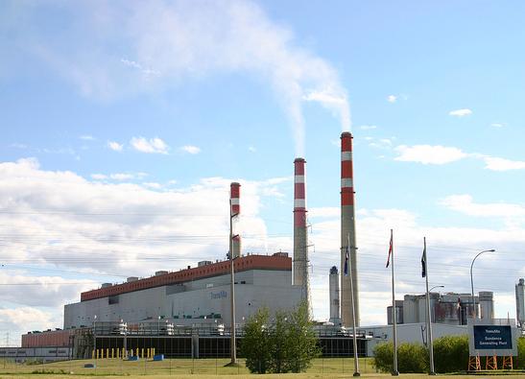
Alberta’s Specified Gas Emitters Regulation (SGER)
Starting 2007: large emitters required to reduce emissions intensities by up to 12% (for comparison, we recommend 42% for oil and gas sector)
Reductions can be achieved by on-site reductions, trading, purchasing offsets, or paying into a technology fund at $15 per tonne

Slide 25
Alberta’s experience: SGER
Strengths
Pioneering policy: the first in North America to apply a carbon price to all large emitters.
Large emitters take GHG management more seriously
Good economic efficiency
Weaknesses
Environmental effectiveness limited by low average carbon price of $1.80/tonne (12% intensity target x $15/tonne)
Integrity of offset system has raised concerns, and companies have unlimited access to it

Slide 26
Alberta’s Technology Fund
Companies are allowed to meet 100% of their target through the technology fund
The fund contribution rate of $15 / tonne acts as the ‘ceiling price’ for the system (i.e. firms are unlikely to invest in reductions above this price)
Reductions happen well into the future
Investments typically cost much more than $15/ tonne, so it doesn’t usually result in one tonne of reductions per credit purchased

Slide 27
Setting the Technology Fund Price
If Ottawa’s regulations include a technology fund, the contribution rate should send a price signal that is designed to be strong enough to get Canada on track for its 2020 target
Economic analysis shows we need a carbon price of over $100/tonne to do that (Pembina and David Suzuki Foundation 2009)
So in a federal technology fund, the price should reach at least $100 a tonne by 2020. $150 a tonne would give a better chance of achieving the target (NRTEE 2012)
Notes:
e.g. National Round Table on the Environment and the Economy (NRTEE) “Reality Check,” 2012, p. 97: Canada will need to take advantage of all emission reduction opportunities up to $150/tonne by 2020 to hit the 2020 target

Slide 28
Putting our Recommendations in Context:
Costs to a typical in situ oilsands facility under various GHG policy options
 | Marginal price signal (cost per tonne) | Maximum compliance cost per barrel produced | Effective average cost per barrel
Alberta SGER | $15 | $0.16 | $0.08
B.C. carbon tax | $30 | $2.73 | $1.37
Norway carbon tax | $71 | $6.46 | $3.23
Recommended approach – lower and higher bounds | $100 | $3.82 | $1.91
 | $150 | $5.73 | $2.87
Notes:
Compliance costs reflect the intensity target multiplied by the system’s maximum price signal (technology fund contribution rate / carbon tax rate). This is a maximum cost for a system operating at its baseline intensity.
Effective average cost per barrel accounts for the interaction with royalty and corporate income tax rates.

Slide 29
…in other words
Our recommended approach would add about $3 per barrel to oilsands production costs
A barrels of oilsands regularly sells for over $70
Additional cost is more than B.C.’s carbon tax but less than Norway’s carbon tax

Slide 30
Alberta’s experience: offsets
Offsets are emission reductions from outside of the regulated sectors
Alberta’s system sets no limit on companies’ access to offset credits (i.e. companies can meet 100% of their target using Alberta-based offset credits)
Offsets were the most popular way that companies met their SGER targets in 2011, accounting for 46% of total compliance
The integrity of many Alberta offsets is questionable
Many come from projects started as early as 2002 – well before the SGER system began – or from practices that are already common
The Auditor-General has raised concerns
Notes:
In 2011, on-site improvements to target were just 13% of total SGER compliance

Slide 31
Managing the Risks of Offsets
Integrity problems with offsets are common
If the federal government allows companies to have access to offsets, the regulations should:
Limit companies’ access to offsets
Set a fixed price for offsets, to prevent companies from seeking out low-cost, low-quality credits
Require “discounting” of offset credits, knowing that some of the credits will not correspond to actual emission reductions

Slide 32
Good Regulatory Design
No matter what architecture the federal government chooses, its oil and gas regulations should:
apply to the vast majority of accurately measurable emissions from the oil and gas sector, including combustion and non-combustion emissions
cover both new and existing facilities
send a clear signal that the stringency of the regulations will increase after 2020

Slide 33
Key Questions to Ask (1)
Will this proposal get Canada on track to hit its 2020 target?
If not, how do you plan to close the gap?
How much will the proposed regulations cost a typical oilsands facility in per barrel terms?
Will the proposed regulations help companies close the gap between the GHG emissions from producing oilsands crude and conventional crudes? If so, by how much?

Slide 34
Key Questions to Ask (2)
What consultation process was used to arrive at this proposal?
How does it reflect the views of the oil and gas industry? How are views from other stakeholders reflected in the proposal?
What options does industry have to take responsibility for its emissions?
Will companies have access to a technology fund? If so, what will the rate be for payments, and how will the funds raised be spent? Will access to the fund be capped or unlimited?
Can companies purchase credits from emission reduction activities outside the sector (e.g. offsets)? If so, how will the government ensure that the reductions are real and verifiable? Will access to these credits be capped or unlimited?

Slide 35
Key Questions to Ask (3)
Will companies have access to credit trading between facilities in the sector, as the federal government’s vehicle regulations allow?
What fraction of the oil and gas sector’s emissions will be covered by this regulation?
Do the regulations cover both new and existing facilities?
How will you ensure that new facilities build in the best available technology?
Will the stringency of the proposal increase after 2020?

Slide 36
Contact Information:
Clare Demerse, Federal Policy Director
613-762-7449
clared@pembina.org
PJ Partington, Technical and Policy Analyst
647-478-9563, ext. 212
pjp@pembina.org

Slide 37
Goal | System | Price / other features
Status quo | AB’s SGER | $15 / tonne 12% target for most emissions Unlimited access to offsets
Match the current best in Canada | BC’s carbon tax | $30/tonne 100% target for all combustion emissions No access to offsets
Match the current best in world for oil and gas producing countries | Norway’s carbon tax | $71/tonne for oil and gas sector (current price)
Get Canada on track to hit 2020 target | NRTEE modelling + Pembina analysis | 42%+ target ~$150/tonne price by 2020
Fair contribution from Canada to 2 degree C | Pembina / David Suzuki Foundation report with economic modelling | $200+/tonne by 2020

Slide 38
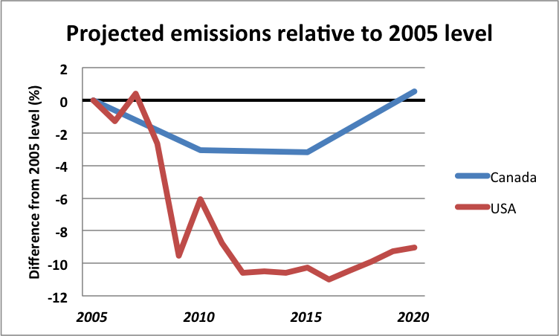
Notes:
Source: Pembina Institute image of projected greenhouse gas emissions trends in Canada and the U.S.A. to 2020 under current policy. Canadian projection from NRTEE (2012); U.S. data from EIA, Annual Energy Outlook 2013 — Early Release. Note: EIA projection covers energy-related CO2 emissions only, compared to all GHGs for Canada, as shown in NRTEE.

Slide 39
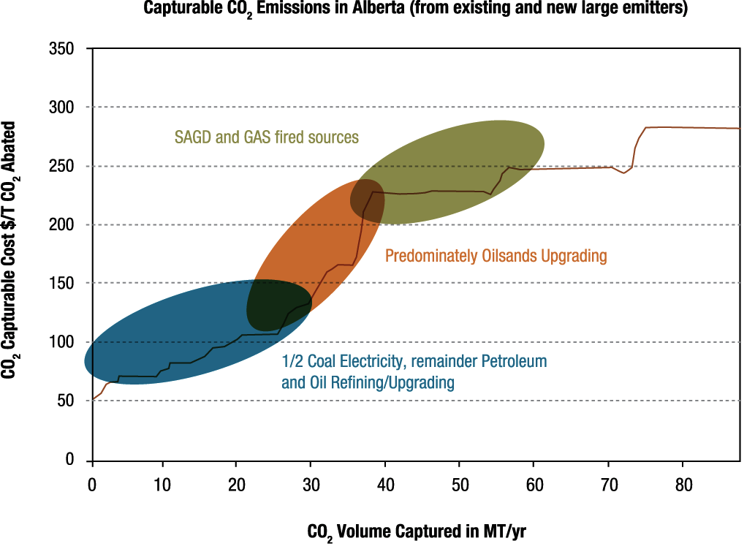
Oilsands carbon capture costs
Current price ceiling:
$15/tonne
Cost of CCS:
$100-280/tonne
Current carbon ceiling price
Notes:
NOTE: this graph shows capture costs, but proponents would need to ad $20–$25 for transport & storage
Little surprise in an environment of $15/tonne that AB is now down to 2 CCS projects: Shell Quest (upgrader) and Alberta Carbon Trunk Line (see http://alberta.ca/acn/201302/33717121A0157-D5E3-839F-750E02B41D039F98.html)

Slide 40
Oilsands Emissions Example
From 2009 report “Climate Leadership, Economic Prosperity”: hitting a target similar to the government’s target would mean
44% GDP growth in AB from 2010 to 2020
8% jobs growth (163,000 net new jobs)
Economy-wide c price of $100+/tonne by 2020
12% reduction in oilsands production relative to business as usual in 2020 (but growth from 2010 production levels)
Notes:
Summary report: http://www.pembina.org/pub/1909
Economic modelling analysis by MK Jaccard and Associates: http://www.pembina.org/pub/1910
SCO production is estimated at 1.9 million barrels / day in 2020 under business as usual; 1.7 million barrels / day under a policy package strong enough to hit the government’s target; and 1.5 million barrels / day under a policy package strong enough to get Canada on track for a “2 degree”-compatible target (21% reduction from BAU) – see p. 76 and 79 for details

Slide 41
pembina.org
pembina.org/subscription
Pembina eNews, Media releases, Publication alerts
twitter.com/pembina facebook.com/pembina.institute

