Slide 1
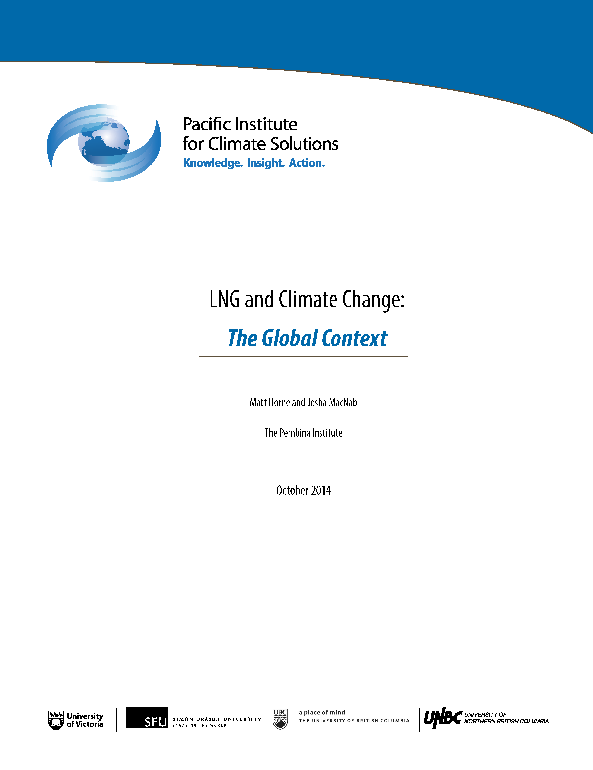
LNG and climate change
The global context
Josha MacNab, B.C. Director Matt Horne, B.C. Associate Director
Pembina Institute
For technical support, call: 1 (604) 354-2628

Slide 2
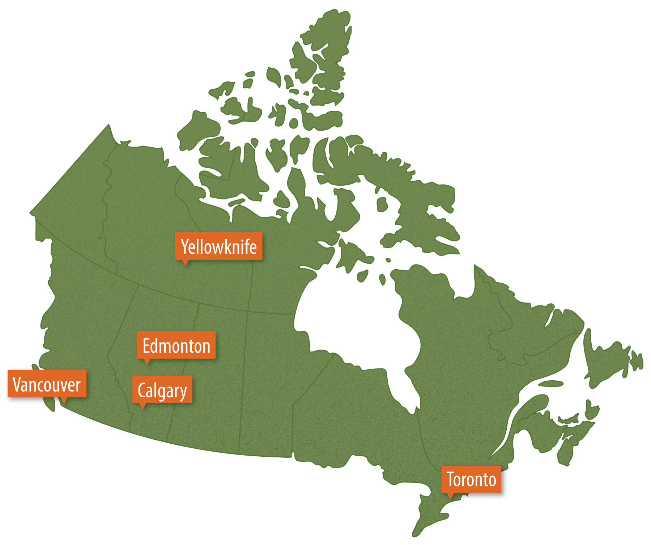
Leading Canada’s transition to a clean energy future
The Pembina Institute is a national non-profit think tank that advances clean energy solutions through research, education, consulting and advocacy.

Slide 3
LNG and climate change
Context
Our research approach
Our findings
Supporting research
Recommendations

Slide 4
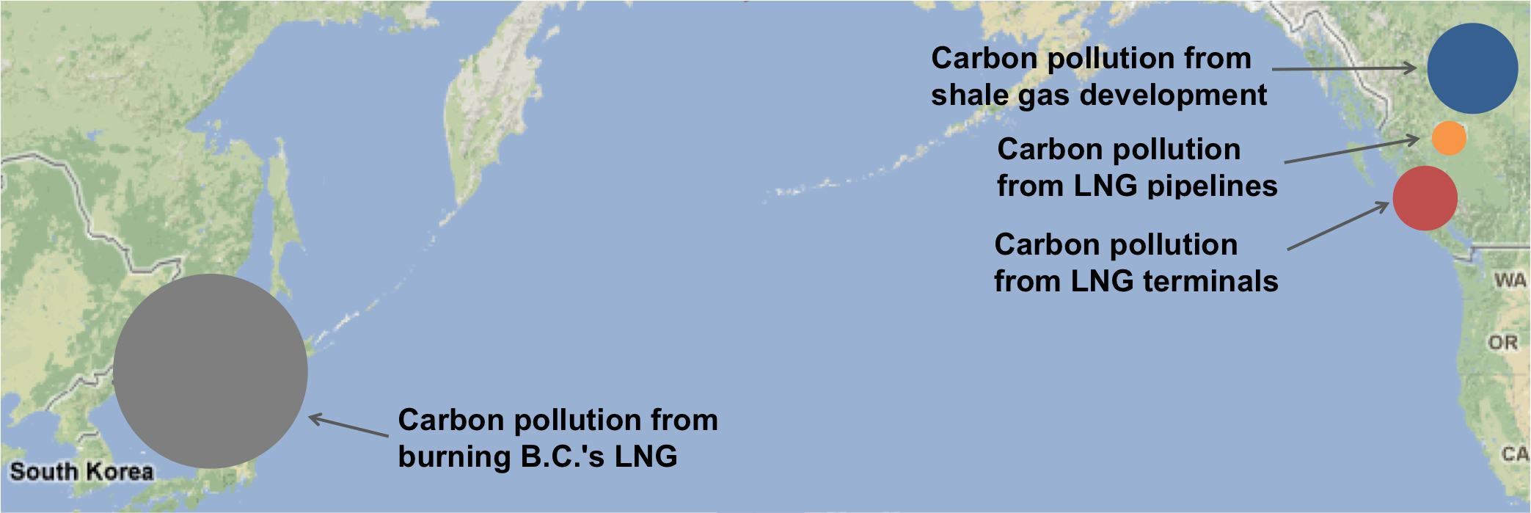
Context

Slide 5
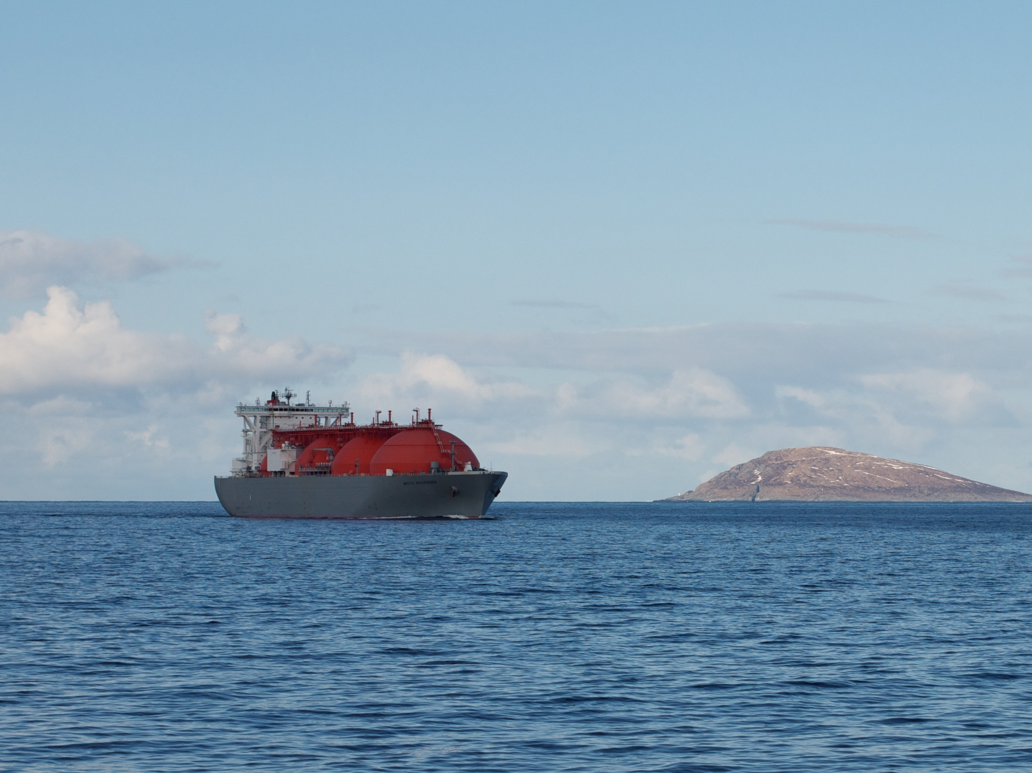
“[Exporting LNG] is the greatest single step we can take to fight climate change.”
B.C. Speech from the Throne
February 2014
Photo by Torbein Rønning on Flickr

Slide 6
The reality
In a world with weak climate policies, natural gas will not reduce coal use and will not help solve climate change.
In a world with strong climate policies:
Demand for natural gas peaks by 2030 and drops below current levels by mid-century.
Energy efficiency, renewables and nuclear enable a transition away from fossil fuels.

Slide 7
Unpacking the claim
The government’s claim is premised on two assumptions:
Natural gas is less polluting than coal
Exports of LNG will displace coal
Overall carbon pollution will drop

Slide 8
Unpacking the claim
The government’s claim is premised on two assumptions:
Natural gas is less polluting than coal
Exports of LNG will displace coal
Overall carbon pollution will drop
The reality isn’t this simple

Slide 9
Unpacking the claim
Assumption 1 is mostly right:
While there is uncertainty, gas is less polluting than coal in most cases if methane is well managed.
Assumption 2 is flawed:
Climate policy, not the availability of natural gas, determines coal use.
Coal and gas aren’t the only options. The broader mix of coal, gas, oil, renewables, nuclear and efficiency determines total carbon pollution.

Slide 10
Our research approach
We reviewed existing research to assess:
What is the role of natural gas in a world with weak climate policies (the world we live in today)?
What is the role of natural gas in a world with strong climate policies (the world we’re trying to transition to)?

Slide 11
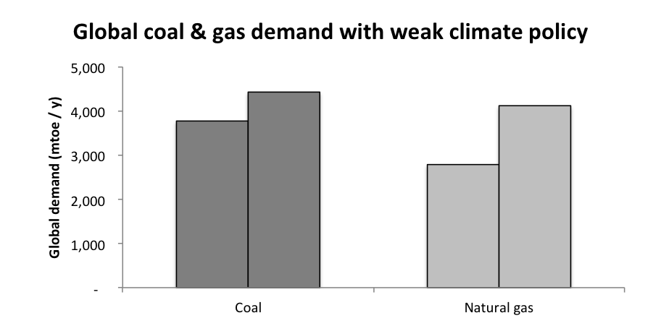
Findings: weak climate policy
2011
2035
2011
2035
Source: International Energy Agency, World Energy Outlook, 2013

Slide 12
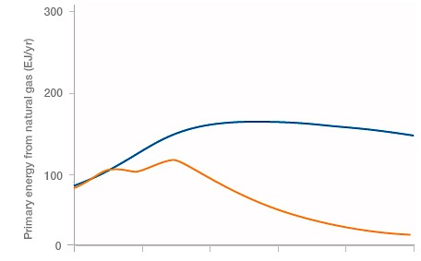
Findings: strong climate policy
2030: Peak
Mid-century: Below current demand
Global natural gas demand with weak climate policies
Global natural gas demand with strong climate policies
Adapted from Levi (2013) “Climate Consequences of Natural Gas as a Bridge Fuel,” Figure 2

Slide 13
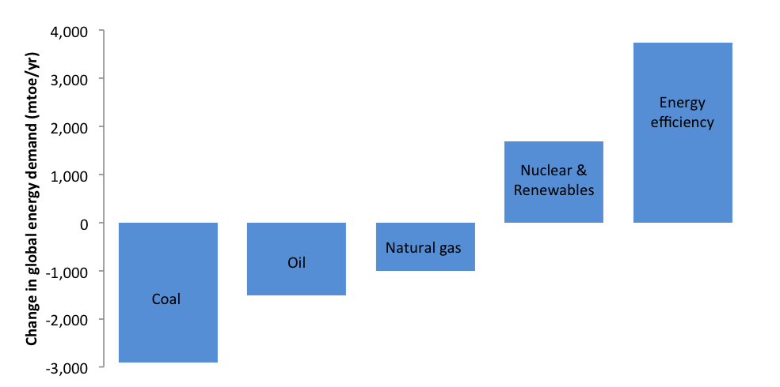
Findings: strong climate policy
Change in projected energy demands in a world with strong climate policy relative to one with weak climate policy
Source: International Energy Agency, World Energy Outlook, 2013

Slide 14
Summary of findings
In a world with weak climate policies, natural gas will not reduce coal use and will not help solve climate change.
In a world with strong climate policies:
Demand for natural gas peaks by 2030 and drops below current levels by mid-century.
Energy efficiency, renewables and nuclear enable a transition away from fossil fuels.

Slide 15
Supporting evidence
Nature, Issue 7523, Oct 2014
“…without new climate policies, abundant supplies of natural gas will have little impact on greenhouse-gas emissions and climate change.”

Slide 16
Recommendations
Apply a consistent, evidence-based, approach in assessing energy exports.
Strengthen domestic efforts to reduce carbon pollution.
Play an increasingly proactive role in encouraging stronger climate policy globally.

Slide 17
Josha MacNab, B.C. Director josham@pembina.org | @jmacnab
Matt Horne, B.C. Associate Director matth@pembina.org | @hornematt
Subscribe to receive email updates from the Pembina Institute:
www.pembina.org/subscription
Twitter: @pembina Facebook: Pembina Institute

