Slide 1

The Impact of the Carbon Tax on Local Government Low-Carbon Projects in B.C.
By: Tim Shah, Climate Action Stories Intern
Pembina Institute
September 21, 2012

Slide 2
Presentation outline
Our research
Methods
Project motivations
Project barriers
The impact of the carbon tax
General observations of the tax
Conclusions

Slide 3
Our Research
  Explored British Columbia (B.C.) local government infrastructure projects that reduce greenhouse gas (GHG) emissions
  Why were these projects implemented?
  How did provincial programs and policies impact the economics of these projects?
    Did the carbon tax have an impact on the economics of their project?

Slide 4
Methods
Literature review
Designing the interview guide
Conducting semi-structured interviews to gather the why
Obtaining quantitative data (financial, GHG reductions) to understand the how
Notes:
Literature review > why are energy conservation retrofits, renewable energy projects, and low-carbon projects implemented? Looking to Europe (particularly Scandinavia as leaders in climate action) to understand why these decisions have been made.

Slide 5
Government | Project
1. Village of Burns Lake | 1. Bioenergy retrofit
2. Capital Regional District (CRD) | 2. Wastewater heat recovery
3. City of Campbell River | 3. Green Roof
4. City of Courtenay | 4. Solar, and geothermal heating
5. City of Dawson Creek | 5. Solar domestic hot water
6. Corporation of Delta | 6. Building retrofit
7. City of Fort St. John | 7. Passivhaus
8. City of Langford | 8. Ice Arena energy efficiency retrofit
9. Township of Langley | 9. Water treatment geoexchange heating
10. City of Prince George | 10. District energy heating system
11. City of Surrey | 11. Green vehicle fleets
12. Resort Municipality of Whistler | 12. Geothermal + solar array system

Slide 6
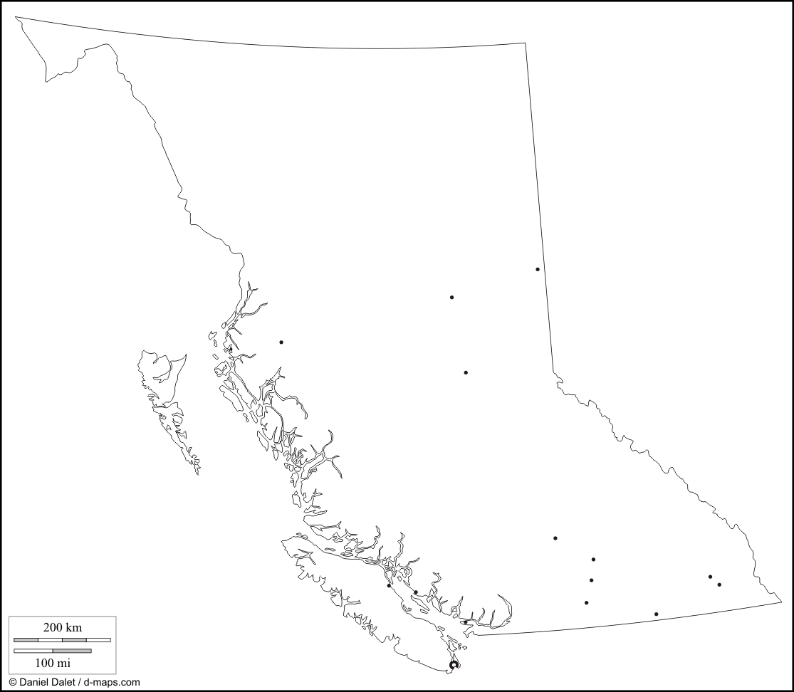
Fort St. John (18,609)
Dawson Creek (11,583)
Burns Lake (2,029)
Campbell River
(31,186)
Prince George (71,974)
Whistler (9,824)
Courtenay
(24,099)
Langley (104,177)
Delta (99,863)
Langford
( 29,228)
Capital Regional District (376,222)
Surrey
(468,251)

Slide 7
Selecting local governments
Diverse sample in terms of geography (location and population)
To find out about projects, we used: Community Energy Association award list, online sources, and past partners
Projects implemented after 2008

Slide 8
Project motivations
Reducing dependence on natural gas
→ CRD, Whistler, Langley, Delta, Courtenay
Demonstrating leadership on climate action
→ Courtenay, CRD, Whistler, Dawson Creek, Delta
Supporting local economy AND energy self-sufficiency → Prince George, Burns Lake
Supporting local charter commitments
→ Surrey, Langley

Slide 9
Common barriers
Achieving buy-in from public
→ Why put taxpayers’ dollars into these projects?
City Council → how good is the ROI?
→ How much energy are we saving?
Newness of technology
Notes:
Speak broadly about the Whistler experience, Campbell River, and Fort St. John.
We did not hear anything about projects not working, they are working just fine. Learning curve for sure, but worth going through

Slide 10
What impact did the following have on the economics of your project?
 | Degree of Impact
Program/policy/grant | Very positive | Somewhat positive | Neutral | Somewhat negative | Very negative
Carbon Tax | 3 | 4 | 5 | 0 | 0
Carbon neutral requirements | 8 | 3 | 1 | 0 | 0
Provincial Grants | 6 | 1 | 5 | 0 | 0
Notes:
Key points here
What did we ask?
We asked: What impact did the following provincial policies/programs have on the economics of your project?
We asked a follow up question: How could this policy/program be improved to help your community implement greenhouse gas reduction projects?
Carbon Tax
-Bottom line: provided an incentive for governments to implement low-carbon project because of reduce natural gas payments (for those who ranked it “very positive” or “somewhat positive”
Carbon neutral requirements
-As each government interviewed for this project is a signatory of the Climate Action Charter, carbon neutral requirements has provided the necessary impetus to implement projects that reduce corporation emissions
-But, some explained how the requirements are vague and not well understood. They are not sure if the requirements will still be in place beyond 2012, or what the carbon offset purchasing process will look like
-A couple of local governments are concerned about the weakening of carbon neutral requirements as the Province has become more lax on the standard by allowing governments to be "working toward carbon neutrality"
Provincial Grants
-Most of this discussion was centred around the CARIP
-Many local governments reported CARIP to be positive because it has enabled some climate action projects

Slide 11
Carbon tax had a positive impact on the economics of these communities:
Capital Regional District (CRD)
City of Dawson Creek
Corporation of Delta
City of Fort St. John
City of Langford
Township of Langley
Resort Municipality of Whistler
Notes:
CRD, Delta, Langford, Langley and Whistler accounted for the carbon tax rate in the financial analysis of their projects.
Langley → Both the carbon tax and the carbon neutral requirements helped Langley make the business case for the geo-exchange system – of the $12,000 in avoided natural gas costs to the system, $2,500 would be avoided carbon tax payments (at $30/tonne of just under $1.50/GJ of natural gas). Additionally, there would be $2,000 annually of avoided carbon offset purchases.
FSJ and Dawson Creek discussed how the tax provided an incentive to do “climate action”, and finally put a price on the environment
Langford:
-if gas prices were to drop to half of where they are, we would still have a winner here; the cost per GJ last fall with the carbon tax was $15.40 for natural gas here in Vancouver Island
-the cost of the heat pumps to use waste heat for energy was $2.25 per GJ of energy, so by using these comparisons, gas would have to come down a long way for it to be non-viable to do it

Slide 12
Select quotes on the tax
“At the end of the day, the more that cost on carbon is clearly understood by staff and clearly linked to operations, the better the job staff will do to reduce those costs. Furthermore, there is no question that the bigger the carbon tax value, the stronger case for the low carbon solution". - Ted Battiston, Manager of Special Projects, Whistler

Slide 13
Price on the environment
“We were clear that we were striving to find a way put a price on the environmental impacts - so lifecycle costing was one, and the carbon tax made that conversation quite a bit easier when it was implemented" - Emanuel Machado, former Director of Corporate Planning and Sustainable Development, City of Dawson Creek

Slide 14
The Business Case
“The carbon tax was included in the financial analysis and helped the staff understand the potential savings associated with displacing natural gas and using a renewable source of energy instead. The tax was an external mechanism that helped us quantify the economic differences between ‘business as usual’ and green infrastructure innovation.."- Sarah Webb, Climate Action Coordinator CRD

Slide 15
Encouraging the low carbon economy
"By having the carbon tax in place, we can say that these energy efficient features will save us money, because we have to pay the tax every year based on how much fossil fuel we consume. Without the tax, I think there is less of an argument for why municipal governments are even in the business of energy efficiency in general" - Marty Paradine, Community Energy Manager, Fort St. John

Slide 16
General observations of the carbon tax
More certainty required about where it is going beyond 2012
Stronger business case for projects
Starting to incentivize the phasing out of natural gas
It has to be higher to be more effective
Notes:
Coal is irrelevant in these communities.
Dialogue about these policies to make sure they get better.
With low natural gas prices now, this can be good for BC. 1) governments could use natural gas (as opposed to dirtier sources of fuel) for sustainable projects, 2) carbon tax just makes it a little more expensive (which means less payments for LGs)
Langford said it was not high enough

Slide 17
Conclusion
Carbon taxes are working, can we do better?
Our research provides evidence for the B.C. carbon tax review
A big appetite for climate action at the local level
Let’s have more clarity around provincial climate policies
Notes:
Confusion and lack of alignment in provincial policies between CNR, CT, etc. Opportunity to make these clearer. There was not a clear understanding about how they overlap, if we want these policies to be more effective, we have to explain how they work together, and general purpose.
WE NEED A DIALOGUE ABOUT THESE POLICIES TO MAKE SURE THEY ARE CLEAR, AND CONSTANTLY IMPROVING
Given that the provincial government is currently in the process of reviewing the carbon tax, the province should note that this policy is driving some local governments in B.C. to invest in low-carbon solutions. By maintaining — and strengthening — existing policies and programs, B.C.’s communities will maintain leadership on climate action in Canada. As Maurice Strong has declared, “the future health of our planet will be determined in our cities.”

Slide 18
Contact Information
Tim Shah, Climate Action Stories Intern, Pembina Institute
Report Available: http://www.pembina.org/pub/2373

