Slide 1
British Columbia’s Carbon Tax
Exploring perspectives and seeking common ground
Matt Horne | Ekaterina Rhodes

Slide 2
Overview
Research approach
Points of consensus
Impacts of B.C.’s carbon tax
Setting the rate
Setting the coverage
Investing the revenue
Conclusions

Slide 3
Research approach
39 confidential interviews conducted in late 2011 to ascertain perspectives on B.C.’s carbon tax.
Participants were selected to obtain a wide variety of input and included large industry, clean tech, local governments, academics and environmental groups.
Participants given the opportunity to review draft findings.
Notes:
Butane Sphere.
Team felt they know all that was required to for the tank location. Ready to make a decision, but required to do an LCVA. During course of the LCVA, a third option was identified – outside of congested plant area. Team realized they hadn’t explored all possible options.
Third option was: 30% lower cost than base case (~1.5million savings), less congestion so reduced construction hazards and scheduling issues, increased safety, increased accessibility, operator and maintenance preference too.

Slide 4
Notes:
Butane Sphere.
Team felt they know all that was required to for the tank location. Ready to make a decision, but required to do an LCVA. During course of the LCVA, a third option was identified – outside of congested plant area. Team realized they hadn’t explored all possible options.
Third option was: 30% lower cost than base case (~1.5million savings), less congestion so reduced construction hazards and scheduling issues, increased safety, increased accessibility, operator and maintenance preference too.

Slide 5
Points of consensus
Climate change represents a serious threat to the environment and the economy — globally, in Canada and in British Columbia.
Government policy will be needed to minimize those risks and protect the environment and economy.
Carbon taxes are one of the important policies government can rely on to minimize the risks represented by climate change.

Slide 6
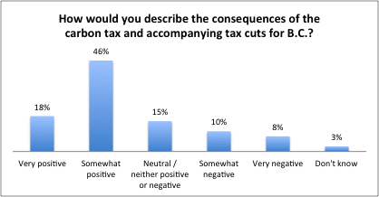
Impacts of B.C.’s carbon tax

Slide 7
Impacts of B.C.’s carbon tax
Early signs of environmental benefit:
  33% of participants viewed the carbon tax as a contributing factor in GHG reduction projects.
  Most of these experiences came from public sector and local governments.
Some concern about economic impacts in certain sectors:
  23% of participants believed the carbon tax was resulting in negative economic impacts.
  Most of these concerns were based on the cost of the carbon tax, without factoring in tax cuts.

Slide 8
Setting the rate
B.C.’s carbon tax was initially set at $10 per tonne in 2008. The rate has increased by $5 every year, and it reached $30 per tonne on July 1, 2012.
There are currently no planned changes to the carbon tax rate at $30 per tonne.

Slide 9
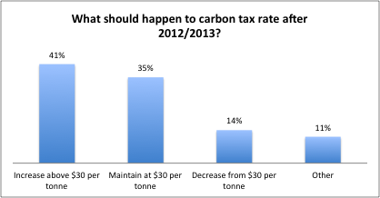
Setting the rate

Slide 10
Setting the coverage
Carbon tax applies to almost all greenhouse gas emissions produced from burning fossil fuels (about 75% of the province’s emissions).
Emissions currently excluded include: process emissions from the aluminum, lime, cement and natural gas sectors, emission from landfills, and emissions from greenhouse growers.

Slide 11
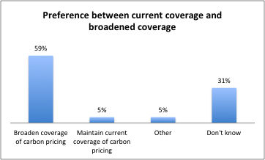
Setting the coverage

Slide 12
Investing the revenue
The carbon tax will generate about $1.2 billion this year.
The Carbon Tax Act currently requires the carbon tax to be revenue neutral (i.e., revenue used to reduce other taxes).
  $721 million to business tax cuts and credits
  $554 million to personal and low-income tax cuts and credits

Slide 13
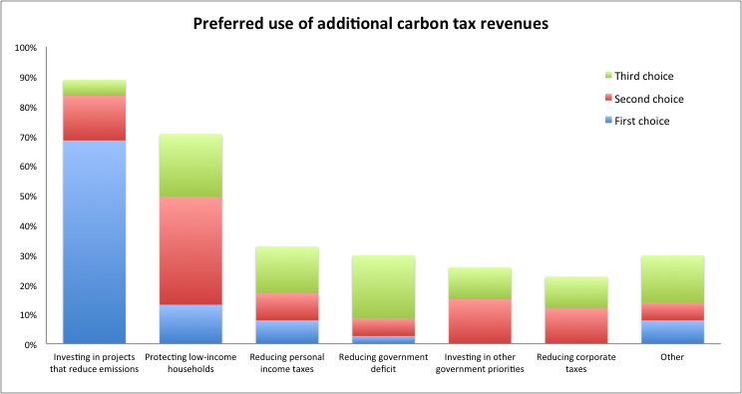
Investing the revenue
s

Slide 14
Conclusions…
…for B.C.’s carbon tax to date:
  Encouraging degree of consensus regarding the need for governments to address climate change and the important role that carbon taxes can play in that response.
  Dominant view is that B.C.’s carbon tax and accompanying tax cuts have been a positive for the province.

Slide 15
Conclusions…
…for the future of B.C.’s carbon tax:
  Carbon pricing should be applied as broadly as possible and carbon tax is preferred approach.
  Priorities for additional revenue should be GHG reduction projects and low-income protection.
  Split perspectives on whether to continue increasing the rate.
  Economic and environmental impacts should continue to be evaluated.
  Communication about the carbon tax and B.C.’s climate change actions should be increased.

Slide 16
Thank you
More information:
Matt Horne | 604.874.8558 x 223 | matth@pembina.org
Report available at: pembina.org/pub/2352

