Slide 1
Competing in Clean Energy
Opportunities and challenges businesses face capitalizing on the global transition to clean energy
Penelope Comette

Slide 2
Global opportunity $1 Trillion $3 Trillion in 2020
1%
Notes:
$1 trillion dollars is the estimated size of the cleantech sector that the global transition to cleaner energy is fueling. The clean tech sector is expected to reach $3 trillion by 2020. – which will make it the 3rd largest global industry sector – 10 times the size of the global areospace. While meteorologists in Australia add new colours to their temperature forecast maps following record heat waves and wild fires, US, European and Chinese energy technology entrepreneurs are busily capitalizing on investments in “decarbonizing” energy systems with their governments standing firmly behind them.
{Click} Canadian entrepreneurs, capture just 1% of the global “cleantech” market, of which largely made up of clean energy.

Slide 3
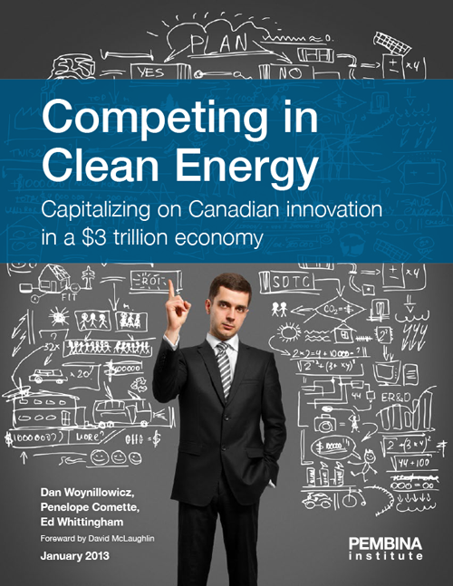
Clean Energy Entrepreneurs:
individuals and companies that design, develop and manufacture clean energy technologies and/or provide supporting services
Notes:
Pembina is excited about the opportunities for Canada in this sector and what it can mean for transitioning to clean energy.
In recent years, there has been much talk about Canada emerging as an “energy superpower,” and in particular a “clean” one. As recently as 2009, Prime Minister Harper said “the only way we are going to stay competitive in the global energy market of the future, is if we are also a clean energy superpower.” {click}
We conducted this research because we wanted to know what was holding the industry back from rapid growth. So we did what Pembina does best – develop practical solutions to energy issues by working with those that are on-the-ground, working in this field.
The strength this report lies in the voices of the people we interviewed (those that live these issues every day)
Entrepreneurs
Investors
Corporate Canada Executives
Academics
We coupled this primary research with an extensive look at the literary research surrounding clean energy technology deployment
What we found was…..
Extra bits
Definition:
The term “clean energy” spans energy production, infrastructure and conservation, and involves technologies and services that promote, enhance or advance: diversity of supply sources and distribution/transmission, efficiency in use, and reduced negative environmental effects such as greenhouse gas emissions. For the purpose of our report, clean energy entrepreneurs are those individuals and companies that design, develop and manufacture clean energy technologies and/or provide supporting services.

Slide 4
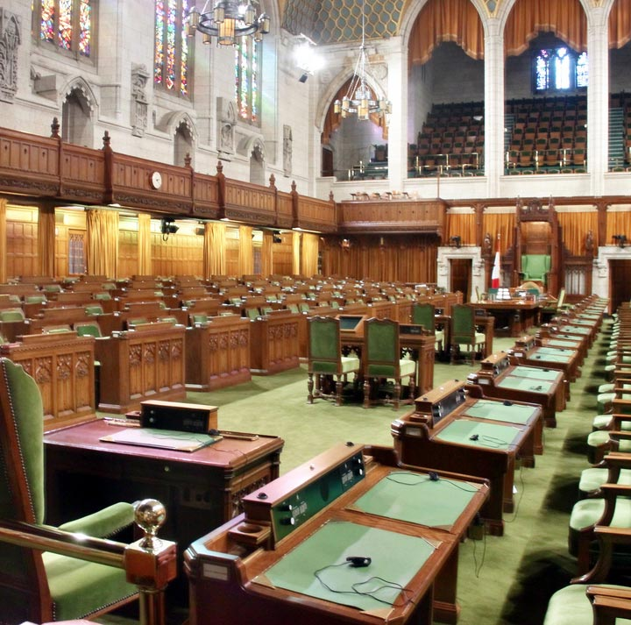
Challenges
Difficulty accessing capital
Lack of long-term, stable policy
Notes:
There are several challenges facing the burgeoning industry. I am just going to give you the top line findings.. The challenges identified fall into 2 main buckets…
Difficulty accessing capital and
Lack of long-term stable policy
So let’s look at the first challenge – difficulty accessing capital

Slide 5
The clean energy innovation cycle
Source: Jenkins and Mansur
PRIVATE EQUITY
VENTURE CAPITAL
DEBT FINANCING
R&D
PROTOTYPE/ PROOF OF CONCEPT
PILOT/ DEMONSTRATION
COMMERCIALIZATION/ MATURATION
MATURITY/ PRICE COMPETITION
TECHNOLOGICAL
VALLEY OF DEATH
COMMERCIALIZATION
VALLEY OF DEATH
Notes:
On this slide is a simplified view of the clean energy innovation cycle –
It illustrates the entire cycle of product development from idea – to commercialized product.
If you look at the blue boxes they identify 2 stages where capital is needed
At the First stage we are seeing decline early stage, venture capital investment this type of investment has decreased from $3.3 billion in 2000 to less than $1 billion in 2012. There are many reasons for this. Of course the market crash of 2008 is one reason but in addition, as identified by Andrew Heintzman (Investeco Capital Corp) is that our large institutional investors, the Pension Funds, have largely moved out of the early-stage investing game.
For for clean energy companies (particularly generation) don’t fit nicely in to traditional asset classes. They have a venture capital risk profile but require infrastructure type capital (traditionally debt financing). In other words they need lots of high risk capital with the promise of lower but longer term rewards. Not fitting neatly into either box makes raising capital a daunting task.

Slide 6
Lack of long-term, stable policy
Challenges
Provincial patchwork approach
Limited support in accessing foreign markets
Fossil fuels’ artificial advantage: externalities and subsidies
Notes:
Our second bucket of challenges for clean energy technology is the lack of long term stable policy either at the Federal or Provincial levels.
Instead of having a single national energy policy as does successful clean energy developing nations such as China and Korea, we in Canada as Tom Heintzman from Bullfrog Power puts it, “have 10 if not 13 different regimes for renewable power” and where we have seen proactive policy such as Ontario’s Feed-In-Tarriff the longevity and the stability is often in question.
In terms of market size we are a small country. Our research indicates there is not enough supportive government policy to help companies prove their technologies and grow domestically before going to bigger, international markets.
fossil fuels enjoy an artificial advantage through government subsidies and the ability of companies to treat the atmosphere as a free or cheap dumping ground for greenhouse gas pollution.” Dawn Farrell,(an economist by training and CEO of TransAlta) believes we will never make the right nor most efficient decisions on how to deal with carbon without a price of carbon.
So what did our research recommend?

Slide 7
Develop toolbox of financial instruments
Solutions
Based on tools already successfully used in other sectors
Recapitalize Sustainable Development Technology Canada (SDTC)
Notes:
To meet the challenges of
Declining early stage investment and the asset class hole problem
Asset class gap
Our research identified 2 main solutions:
Developing a toolbox of financial instruments to meet meet the challenges of capital intensive clean energy technologies. Some of the examples are:
“Green Bonds” – which Tom has written extensively about
Flow through shares – a tax subsidy common in the extractives sector
To quote Mike Brown of Chrysalix Energy Ventures” SDTC has more to do with the advancement of clean teck in Canada than any other single body’. We are recommending the Federal Government recapitalize SDTC at a rate of $100M/year for 5 years starting this budget year – 2013.

Slide 8
Send the right price signals
Solutions
Eliminate preferential tax treatment for fossil fuel production
Establish national carbon price
Notes:
Fossil fuel energy continues to benefit from government subsidies and the externalization of costs associated with its greenhouse gas pollution.
Our recommendation is to continue to remove inefficient fossil fuel subsidies as we committed to removing in at the 2009 G20 meeting in Pitsburg. The phasing out of the Accelerated Capital Cost Allowance for oilsands is a strong start but will account for less than 30% of all tax expenditure support. We would like to see the government continue to phase out the other tax expenditure support for fossil fuels.
Establishing a national price on carbon was the single most consistent theme running through our research. From diverse voices such as Dawn Farrell at TransAlta to John Coyne at Unilver to John Ruffolo at OMERS Ventures. Pricing carbon

Slide 9
Develop national energy strategy
Solutions
Leverage value of fossil fuel to support clean energy development and deployment domestically
Enhance international export opportunities
Notes:
To solve the problems of a patchwork approach to clean energy policy domestically and difficulty accessing international markets.
We say develop an national energy strategy. Learn from leading countries and create a national standard that is long term and is focused on generating demand. This will allow companies to gain efficiencies of scale and create a less risky investment climate And hey by our calculations if the federal government removing the support provided through tax expenditures currently offered to the fossil fuel industry, based on our estimates, would free up over a billion dollars which could then in turn be used to support Canadian clean energy technology – including the recapitalization of SDTC.
Enhance international export opportunities – as the President of Export Development Canada said –” these companies need to scale up and go global we need to work together to help put Canadian companies at the forefront of the industry”.

Slide 10
Download full report:
pembina.org
Notes:
Develop toolbox of financial instruments
Send the right price signals
Develop national energy strategy
On our panel
Dan can regale you with his personal challenges and successes as a successful clean energy developer and
Tom can speak from his depth of experience working with entrepreneurs as an advisor, an investor and as one who focuses a good portion of his time on the intersection between public policy and clean energy technology.
I can speak to the research in our report and give further voice to our interviewees
I look forward to diving deeper into this discussion and talking about what we’ve collectively learned and uncovering new solutions.

