Slide 1
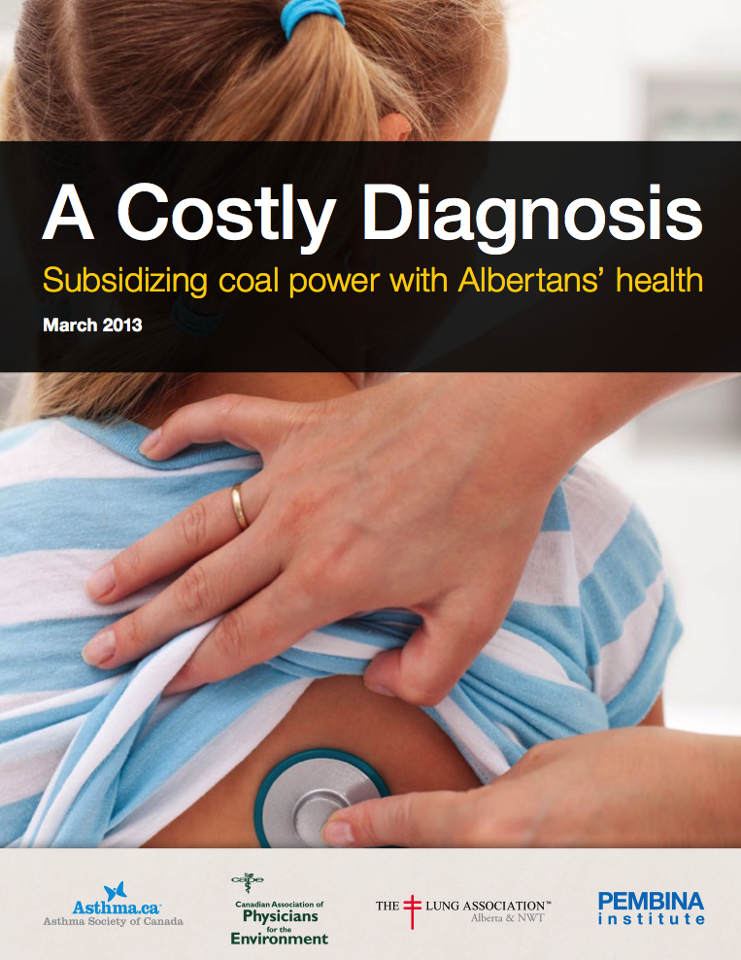

Slide 2
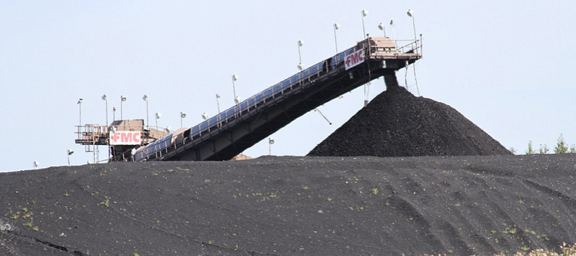

Alberta burns more coal than rest of Canada combined
Electricity generation from coal in Canada in 2010 (GWh)
Source: Statistics Canada

Slide 3

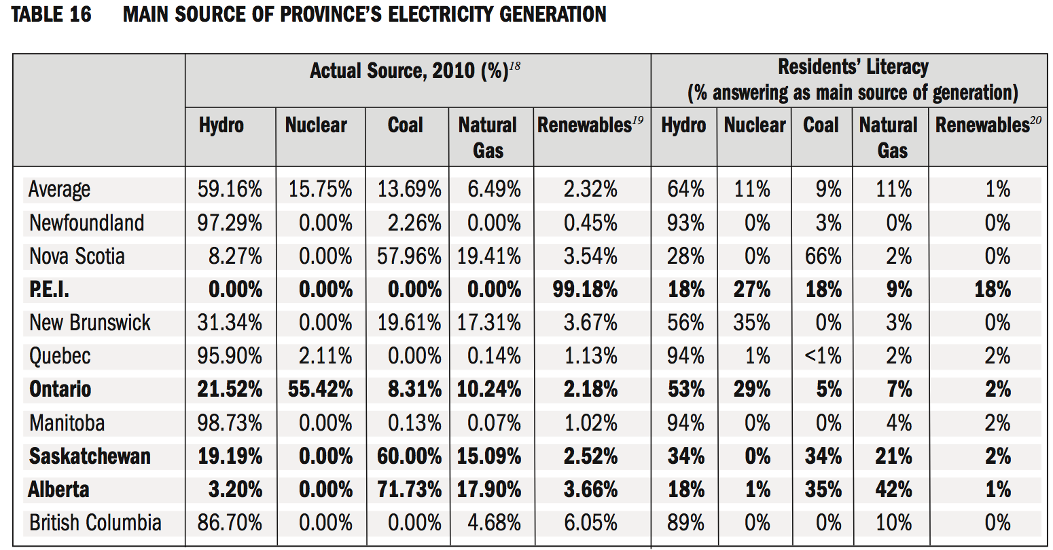
http://policyschool.ucalgary.ca/sites/default/files/research/energy-literacy-survey.pdf

Slide 4
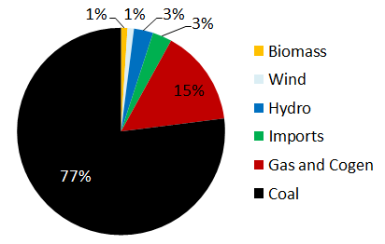
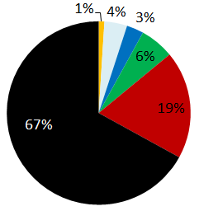

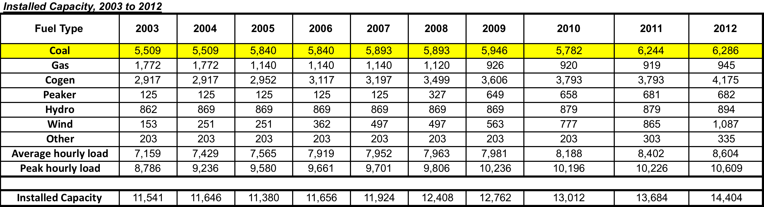
2011
Alberta Electricity Generation
2006
Source: Alberta Electric System Operator

Slide 5
Coal Plants in Alberta

Slide 6
Federal GHG regulations allow last coal plant to operate unmitigated until 2062

Slide 7
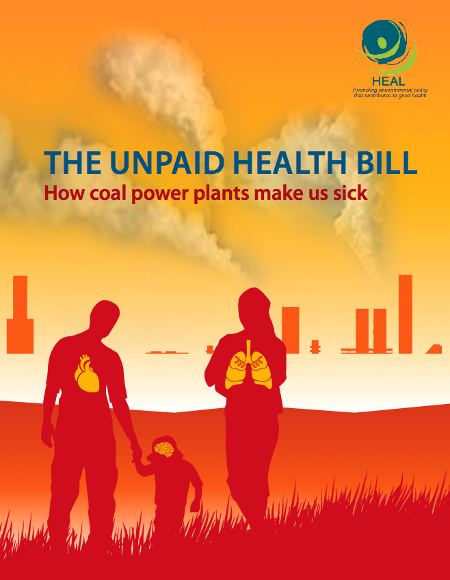
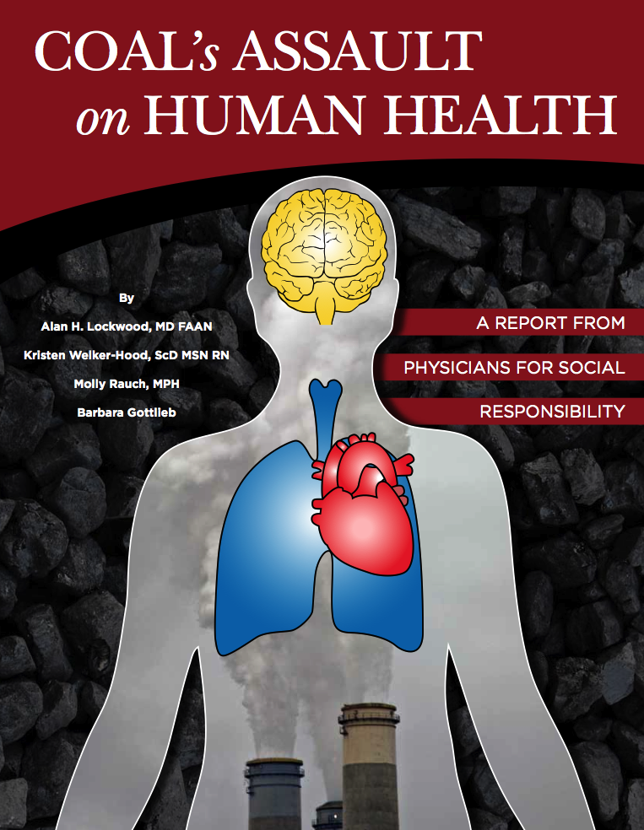
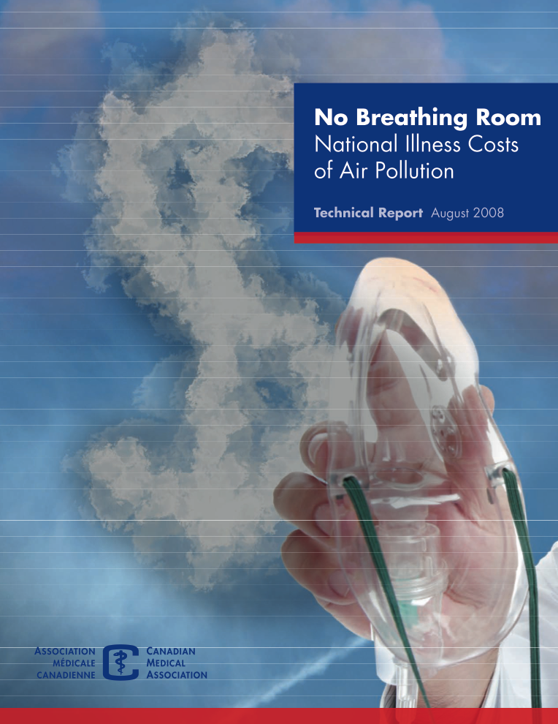
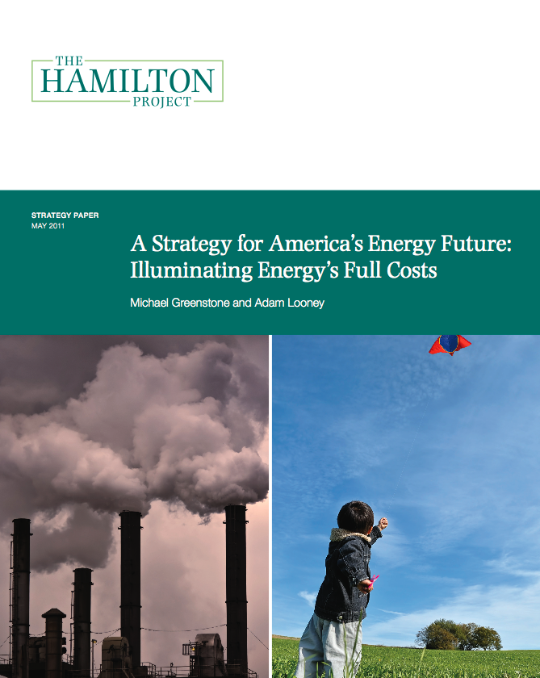

Slide 8
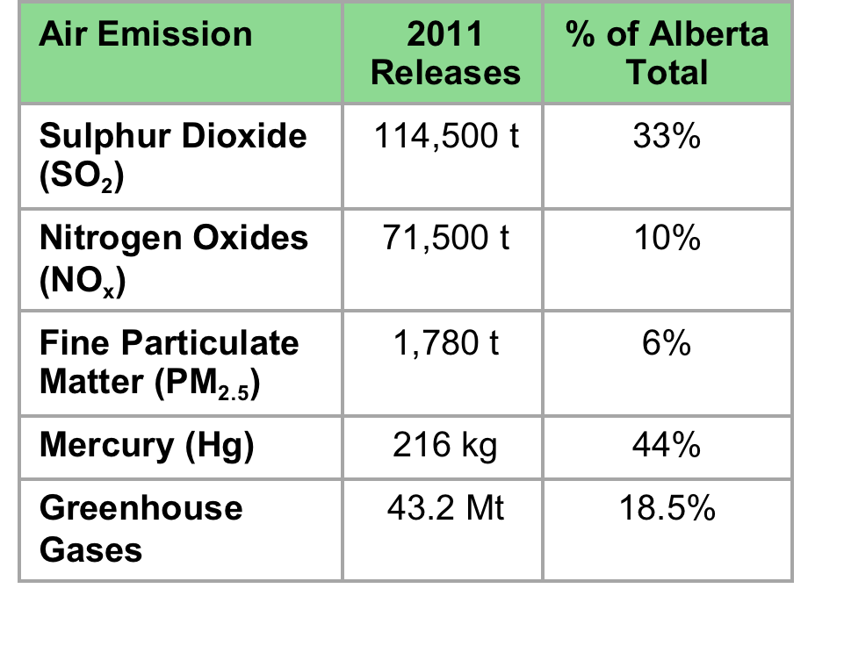
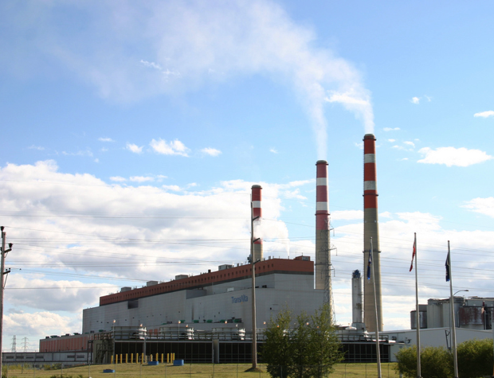
Coal emissions in Alberta

Slide 9
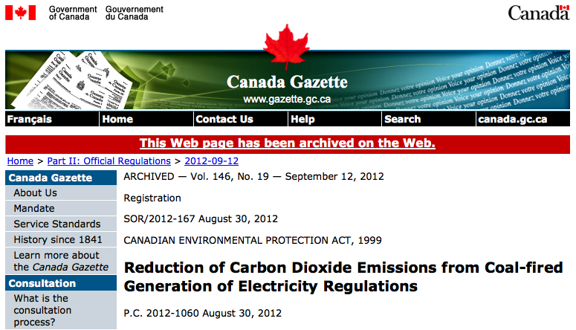
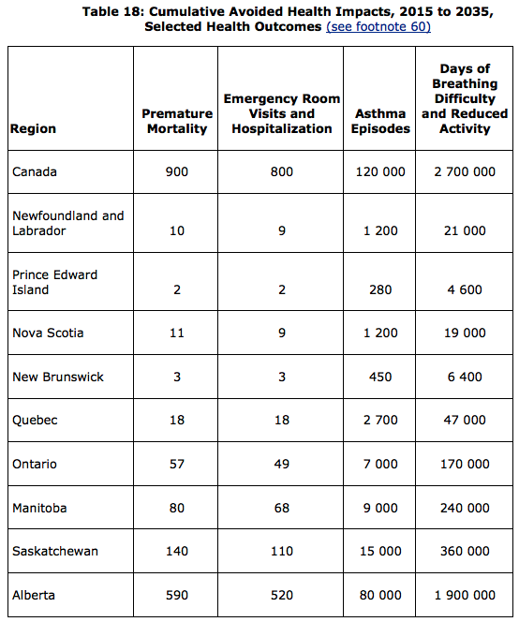
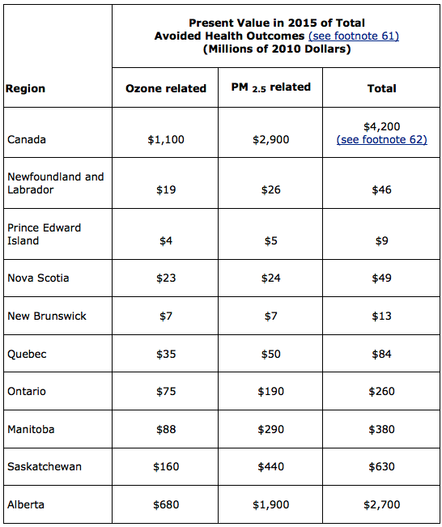
Estimating damages
http://canadagazette.gc.ca/rp-pr/p2/2012/2012-09-12/html/sor-dors167-eng.html

Slide 10

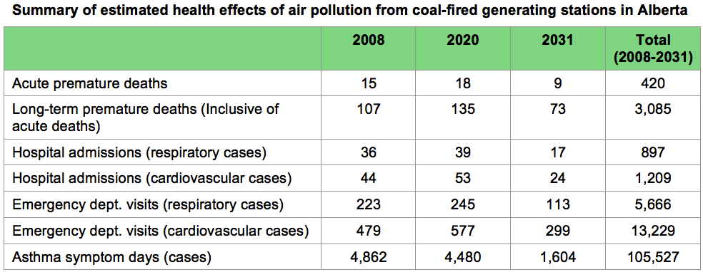
Estimating damages

Slide 11
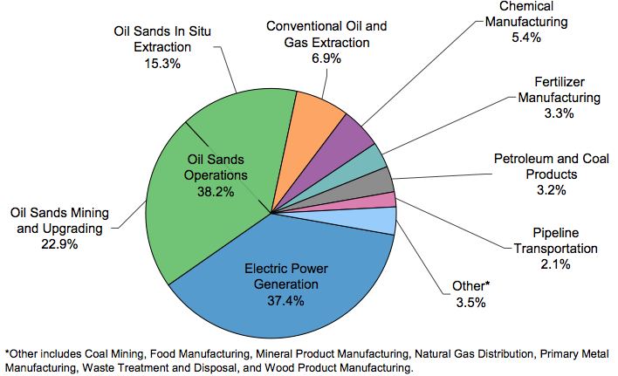
Climate change is a health problem
“Climate change could be the biggest global health threat of the 21st century.”
The Lancet Medical Journal (2009)
“By 2030, the direct cost to health is expected to be between US$2 and US$4 billion per year.”
World Health Organization (2012)
2010 industrial GHG emissions in Alberta
Source: Alberta Environment and Sustainable Resource Development (2012) Report on 2010 Greenhouse Gas Emissions

Slide 12
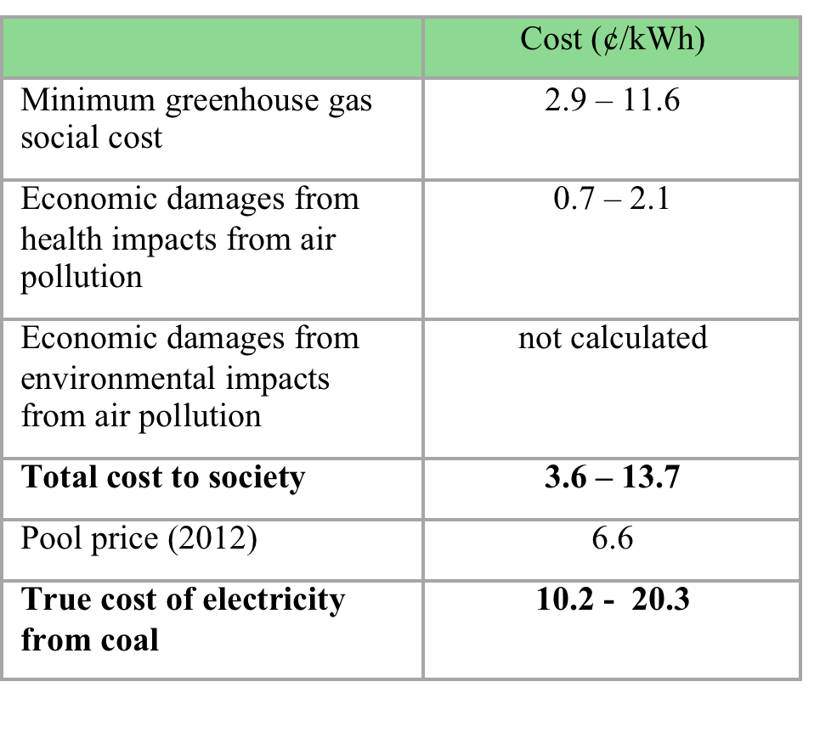
Total costs

Slide 13
Recommendations
Alberta’s electricity market does not account for health and climate costs
  Renewables and other low carbon technologies not competing on a level playing field
Federal regulations phase out conventional coal by 2062
  Alberta can do better
  GHG action will have health co-benefits

