Slide 1
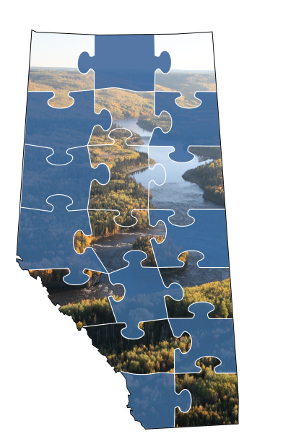
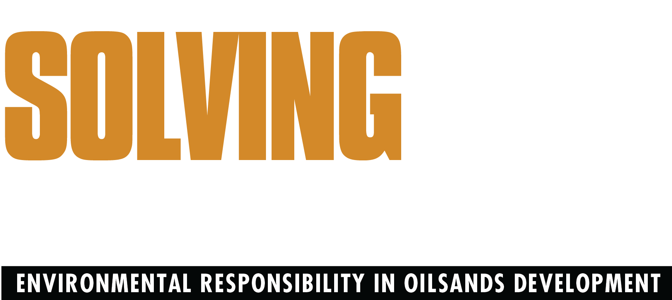
LAND • WATER • AIR • GREENHOUSE GASES • MONITORING
April 2013

Slide 2
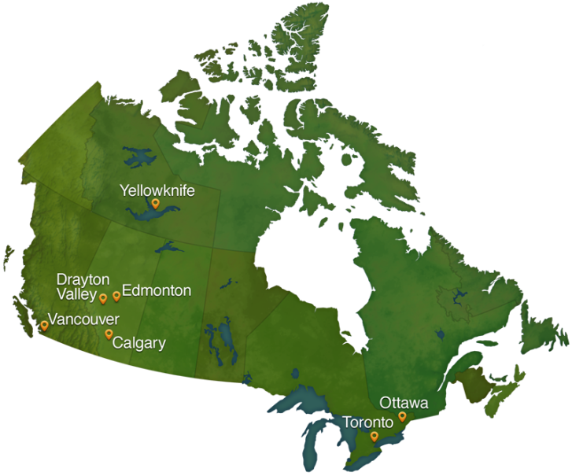
The Pembina Institute
The Pembina Institute is a national non-profit think tank that advances clean energy solutions through research, education, consulting and advocacy.

Slide 3
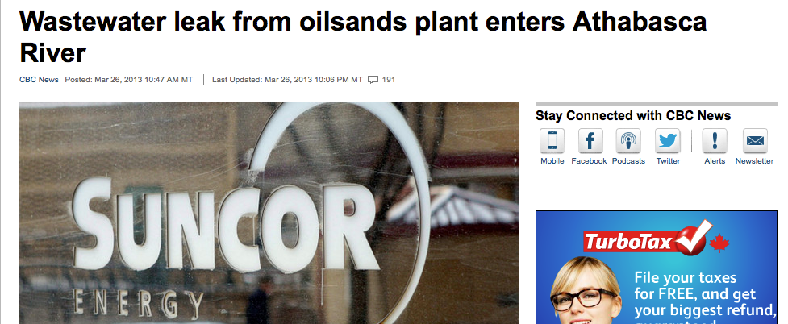
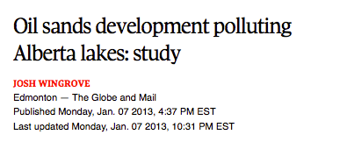
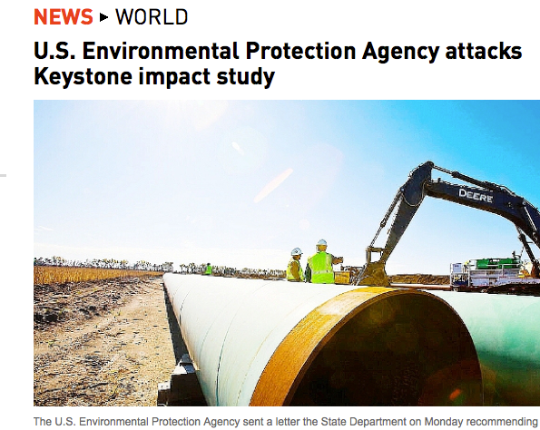
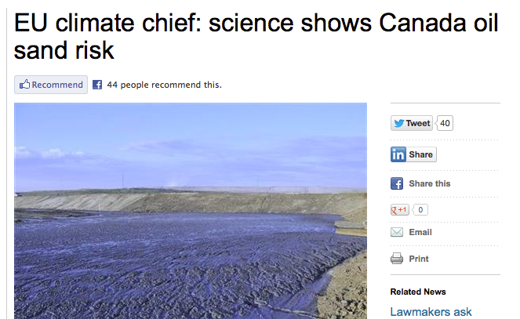
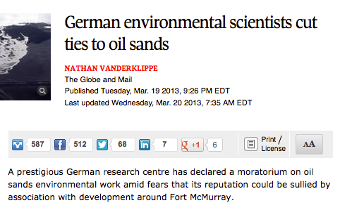
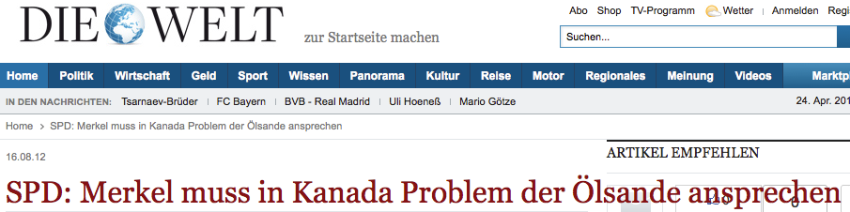
Oilsands Coverage

Slide 4
Alberta GHG increase in context

Slide 5
Oilsands emissions trends
Source: Environment Canada National Inventory (1990-2008), Environment Canada GHG Forecast 2012

Slide 6
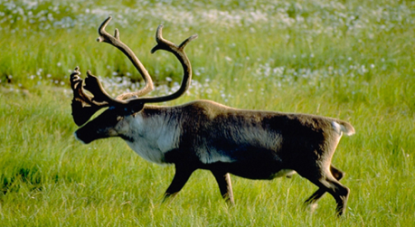
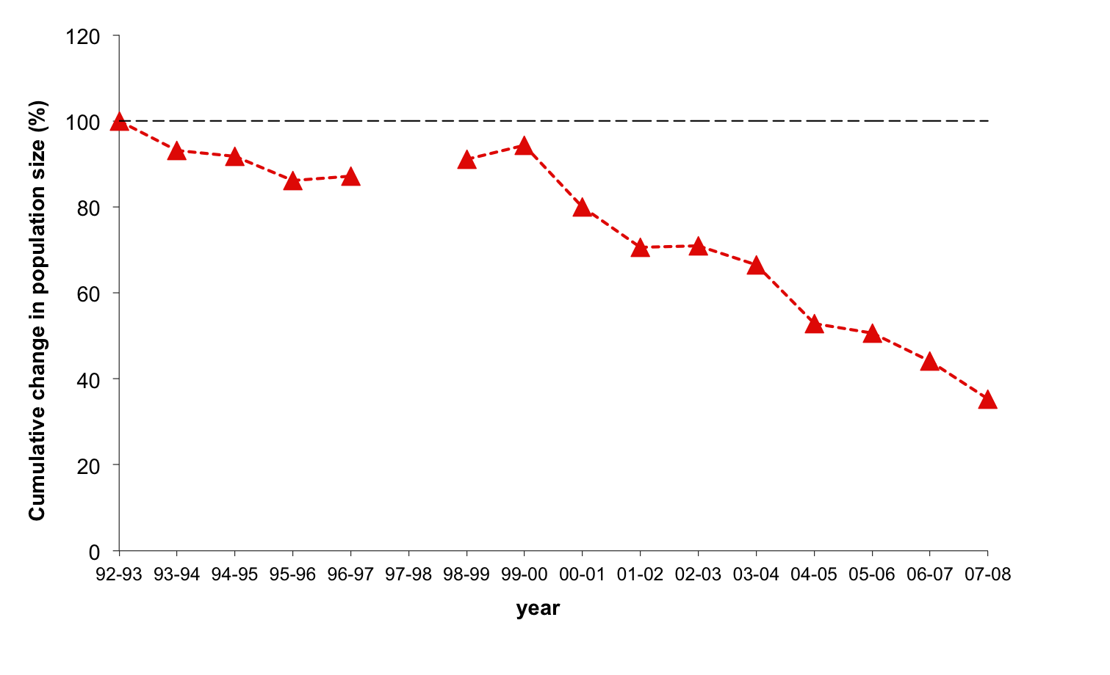
Woodland caribou in decline
East Side Athabasca Herd
~ 65% decline in 16 years
Source: Alberta Woodland Caribou Recovery Team. Alberta Woodland Caribou Recovery Plan 2004/05 – 2013/14 (2005). Alberta Caribou Committee (DRAFT) unpublished data 2005-2008

Slide 7
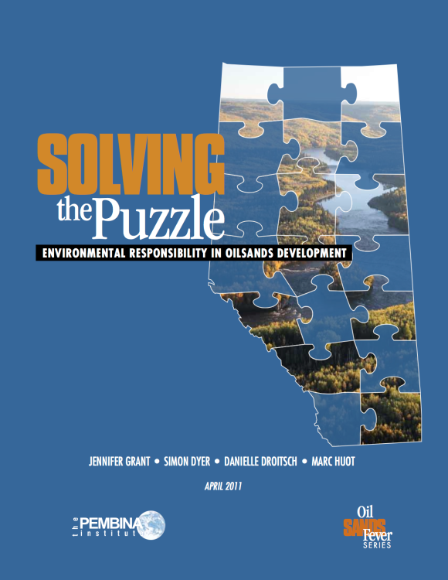
Solving the Puzzle: context
Move the polarized debate to discussion about addressing impacts
Solving the Puzzle outlines 19 policy solutions to oilsands impacts
Released in April 2011
Download Solving the Puzzle at:
http://www.pembina.org/pub/2210

Slide 8
Solving the Puzzle: context
Legitimate concerns about oilsands environmental management
Opposition to oilsands and related infrastructure increasing
Most concerns have solutions that can be addressed through stronger regulation

Slide 9
Solving the Puzzle: progress
SUBSTANTIAL
MODERATE
LIMITED
2
5
12

Slide 10
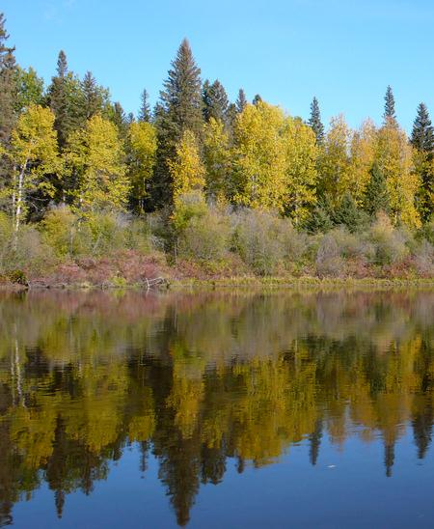
LAND: land protection
The Government of Alberta should legislatively protect at least 50% of its public forested lands from industrial development
  Protected areas should be developed and co-managed with Aboriginal peoples
PROGRESS SINCE APRIL 2011:
SUBSTANTIAL

Slide 11
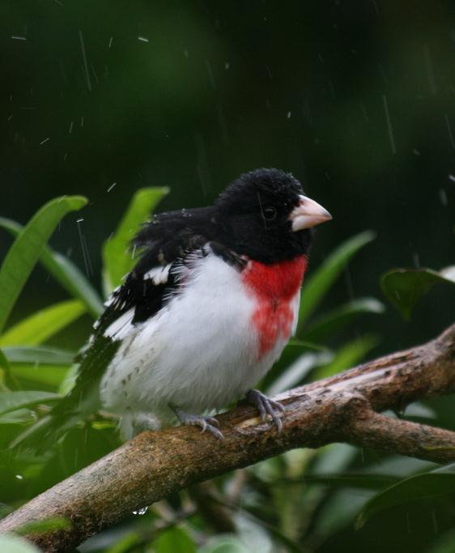
MONITORING: biodiversity monitoring
Ensure full funding of the Alberta Biodiversity Monitoring Institute (ABMI)
  Fund directly by government or through mandatory payments from natural resource developers who impact biodiversity as a condition of regulatory approval
PROGRESS SINCE APRIL 2011:
SUBSTANTIAL

Slide 12
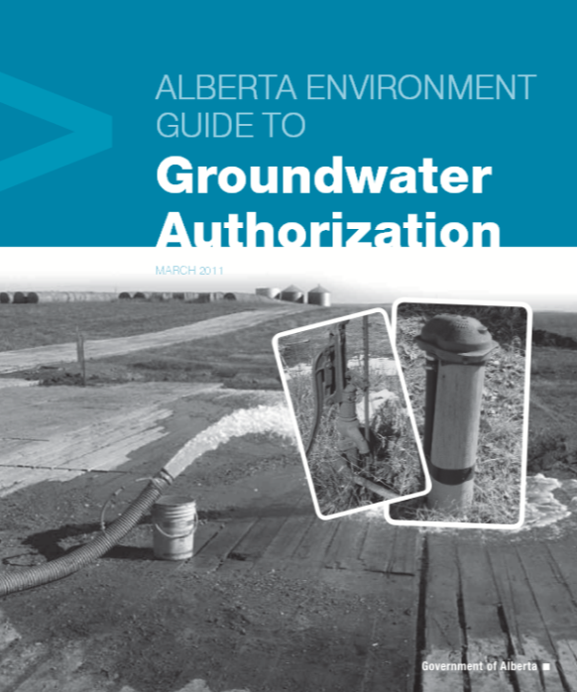
WATER: groundwater regulations
Ensure enforceable regulations are in place to protect non-saline groundwater resources
  Update and implement existing guidelines and definitions
  Expand definition of regulated groundwater from 4,000 mg/L TDs to include water with up to 10,000 mg/L TDS
PROGRESS SINCE APRIL 2011:
MODERATE
Notes:
Both mining and in situ production impact groundwater resources. The in situ sector (and its anticipated growth) is of particular concern. Groundwater moves slowly and recharge rates are slow. Groundwater withdrawals from aquifers for in situ development can impact surface waters and it’s hard to predict how long it takes for an aquifer to recover.
There are about 40 in situ projects operating; and another ~50 or so approved projects (and even more than are proposed!)
Despite the approval of close to 100 projects still a number of unknowns:
Cumulative impact of groundwater use
How aquifer disturbance (say from mining) affects groundwater quality
Is there any data to assess the claim that the deep injection of steam and waste doesn’t negatively impact the regional and local aquifers
What the impacts are of reducing non saline aquifer supplies; or dewatering saline aquifers…

Slide 13
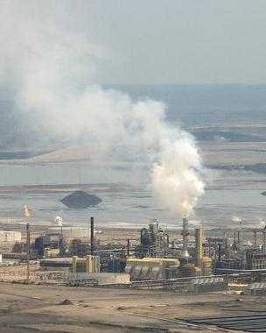
AIR: air quality guidelines
Establish air emission limits to achieve the World Health Organization’s Air Quality Guidelines
  Implement a progressive, multi-tiered system that required varying degrees of action to prevent degradation of ambient air
  Protect air quality and human health
PROGRESS SINCE APRIL 2011:
MODERATE

Slide 14
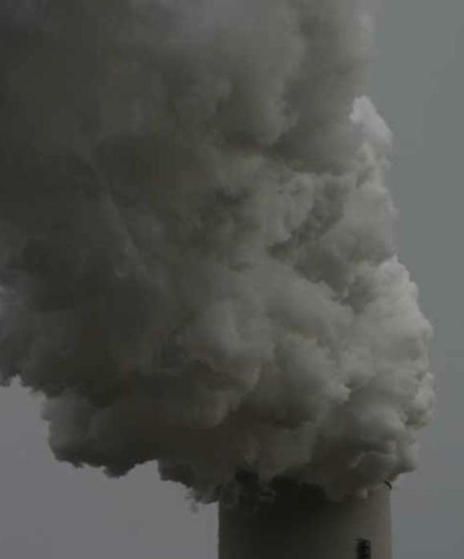
AIR: air emissions
Require oilsands operations to use equipment with the lowest achievable emissions or to deploy best-available technology for emissions reduction
PROGRESS SINCE APRIL 2011:
MODERATE

Slide 15
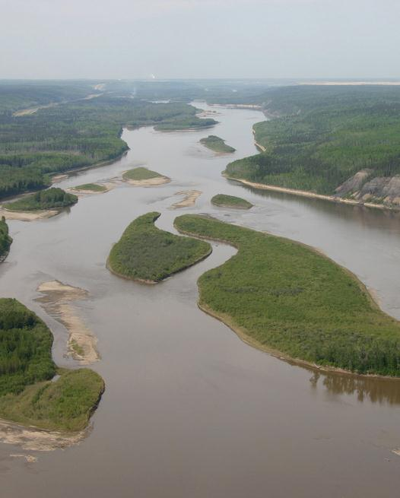
WATER: Protect the Athabasca River
AESRD should complete a water management plan that identifies a science-based EBF for the lower Athabasca River
  Low-flow threshold below which all water withdrawals must cease
  Legally enforceable and accounted for in cumulative water withdrawal permits
PROGRESS SINCE APRIL 2011:
LIMITED
Notes:
Athabasca River has huge flow variability depending on the season.
Currently oilsands operators are allowed to withdraw water from the Athabasca River throughout the year, even when flows get dangerously low in winter months.
Not properly recognizing seasonal variations in the Athabasca River’s flow when managing oilsands development imperils the aquatic ecosystem of one of Alberta’s most ecologically and culturally important rivers.

Slide 16
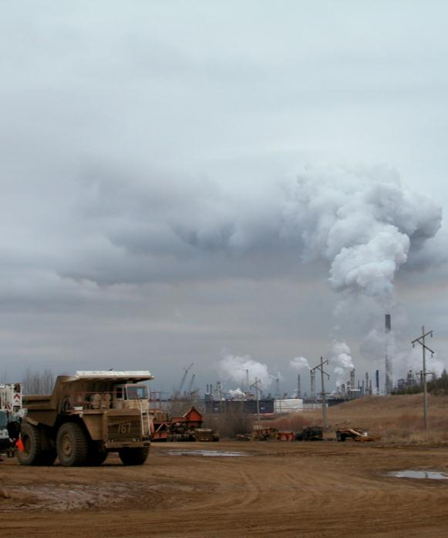
GHGs: raise pollution levy
Implement an escalating carbon dioxide equivalent (CO₂e) emission price
  Either a full auction cap-and-trade system or a carbon tax covering all combustion and almost all fixed process emissions
PROGRESS SINCE APRIL 2011:
LIMITED

Slide 17
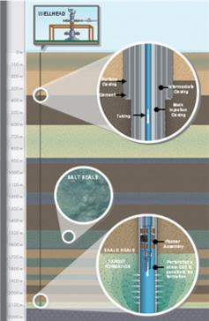
GHGs: mandate carbon capture
Mandate the use of carbon capture and storage (CCS) technology to capture GHG emissions from all major new industrial sources by 2016
Applicable to:
  Formation, process, and combustion CO₂
PROGRESS SINCE APRIL 2011:
LIMITED
Image: shell.ca/quest

Slide 18
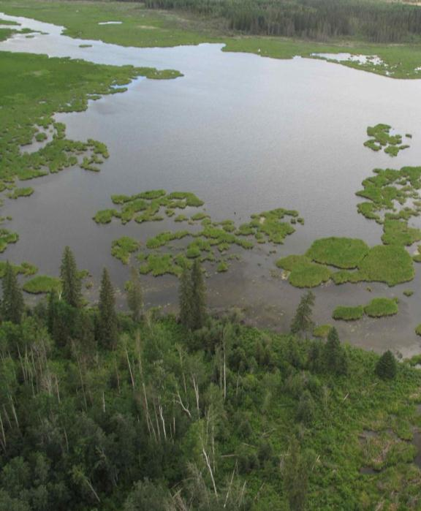
LAND: biodiversity offsets
Require establishment of biodiversity offsets for all oilsands development to offset impacts to all habitat types
  3:1 offset ratio will ensure a net positive environmental benefit and address existing cumulative effects
PROGRESS SINCE APRIL 2011:
LIMITED

Slide 19
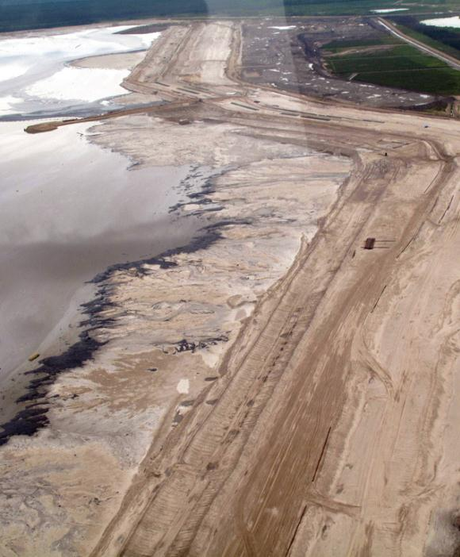
LAND: mine financial security program
Develop a new, transparent and risk-averse mine security program that ensures the Alberta government collects financial security equivalent to the total liabilities created by oilsands extraction
PROGRESS SINCE APRIL 2011:
LIMITED

Slide 20
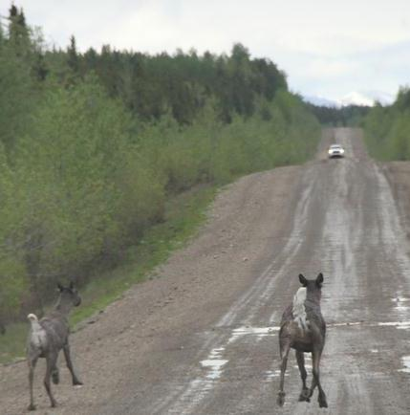
LAND: woodland caribou conservation
Follow Alberta Caribou Committee recommendations
  All caribou ranges in Alberta must meet science-based objectives to maintain caribou populations
    Protected areas
    Maximum development level thresholds in caribou habitat
    Biodiversity offsets
PROGRESS SINCE APRIL 2011:
LIMITED

Slide 21
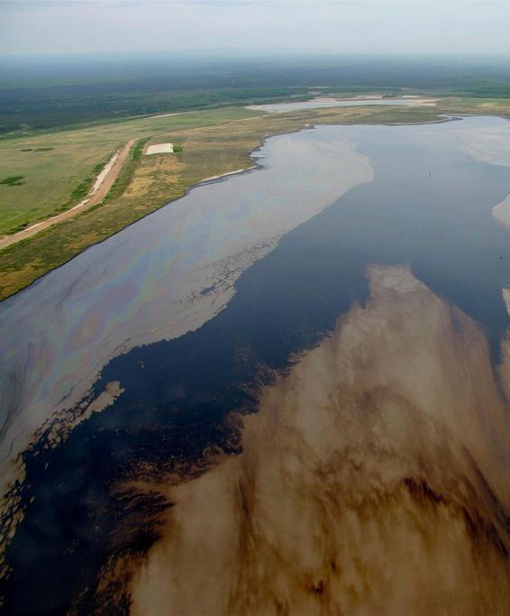
WATER: clean up tailings
New mines should not be approved unless they adopt a proven technology that eliminates the creation of wet tailings
  All current mines should conform to the new tailings rules in the interim
PROGRESS SINCE APRIL 2011:
LIMITED
Notes:
Tailings continue to grow despite the ERCB’s 2009 tailings directive for two reasons:
Rules only target a proportion of new tailings production (i.e,. 50% must be made trafficable – intensity type target), doesn’t deal with tailings that accumulated on landscape before 2009.
Lack of enforcement
Tailings impacts:
Tailings area: 176 km²
Tailings volume = 830 million m³ (220 billion gallons)
Volume projected to increase by 40% by 2030 (under current policy)
Acute & long-term toxicity
Contain naphthenic acids, residual hydrocarbons
Source of methane, VOCs and H₂S emissions
Ample technologies in the works – companies need regulatory incentive to deal with 100% of tailings waste either through new treatment or extraction technologies.

Slide 22
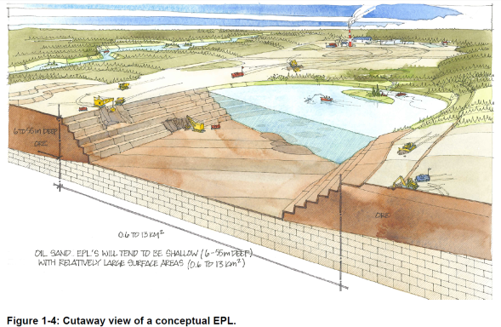
WATER: no new end pit lake approvals
Mine applications that propose storage of tailings under end pit lakes as their reclamation strategy should not be approved
  Existing operations with approved end pit lake plans should be modified
PROGRESS SINCE APRIL 2011:
LIMITED
Image: cemaonline.ca
(End Pit Lake Guidance Document)
Notes:
End pit lakes that permanently store tailings waste has been proposed as an affordable means to “reclaim” tailings.
Mine pit + tailings waste + cap of fresh water + two layers that never mix = proposed end pit lake as tailings dump site.
Problem is that it’s never been done before.
Unnecessarily risky way to deal with tailings – puts the problem off until end of mine life. Could present huge environmental liability if the experiment doesn’t work out.
Regulators have approved EPLs as permanent dump sites for tailings waste, “subject to their demonstration”
Could be a decade or more to learn from the new Syncrude demonstration lake (Base Mine Lake).

Slide 23

Solving the Puzzle: conclusions
With notable exceptions, progress on addressing oilsands environmental policy gaps has been disappointing
Poor environmental performance = barrier to market access
Urgent need to accelerate environmental regulation improvements
PROGRESS SINCE APRIL 2011:
LIMITED PROGRESS ON 12/19 POLICY RECOMMENDATIONS

Slide 24
pembina.org
pembina.org/subscription
Pembina eNews, Media releases, Publication alerts
twitter.com/pembina facebook.com/pembina.institute

