Slide 1
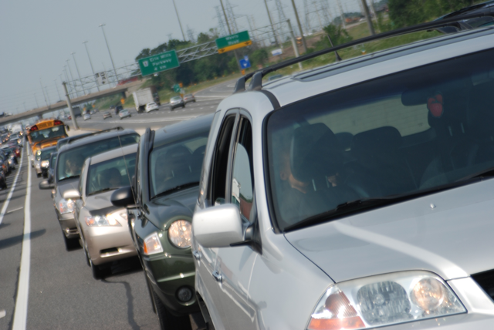
A Commuter Choice Survey of Drivers in the GTA

Slide 2
We surveyed…
1000 Drivers
Only in the GTA
30 minute minimum commute one way
Mean one-way commute time – 43 min
84% take major highway
70% between 35-59 yrs of age

Slide 3
TOPLINE FINDINGS

Slide 4
Commuting by Car is Stressful
70% drive to work 5 days a week, and 2/3 experience some level of stress during their commute.
2/3 say commuting takes away from quality of life in terms of family and personal time
Over half of drivers (56%) surveyed do not currently have access to a rapid transit alternative.
1/3 have access to GO train and/or Subway

Slide 5
Reasons for not taking Rapid Transit
Takes too long
Too many transfers
Too far to access
Need car for errands along way
Don’t like it
Need car for my job

Slide 6
Rapid Transit Options
Education and information were built into the survey – We explained rapid transit options with pictures and descriptions…

Slide 9
Interest in taking Rapid Transit
Light rail transit (LRT): 69% 40 + 29
Subway: 68% 44 + 24
GO train: 64% 35 + 29
Rapid Bus: 55% 26 + 29
Rapid Streetcar: 38% 17 + 21
(very + somewhat interested)

Slide 10
There is a very high interest in alternatives to commuting five days a week by single occupancy vehicle
Likely to take advantage of….

Slide 11
94% would be interested in telecommuting if offered by their employer.
2/3 would likely try “pay as you drive” auto insurance if it were available and of these, 85% would change their commuting habits to find some other way to get to work if they had pay-as-you-drive insurance.
63% would be likely to trade their employee parking spot for cash and find another way to get to work if a parking cash-out program were available.
Over 60% of drivers would consider carpooling if there were an added incentive to do so, such as flexible work hours or a financial incentive.

Slide 12
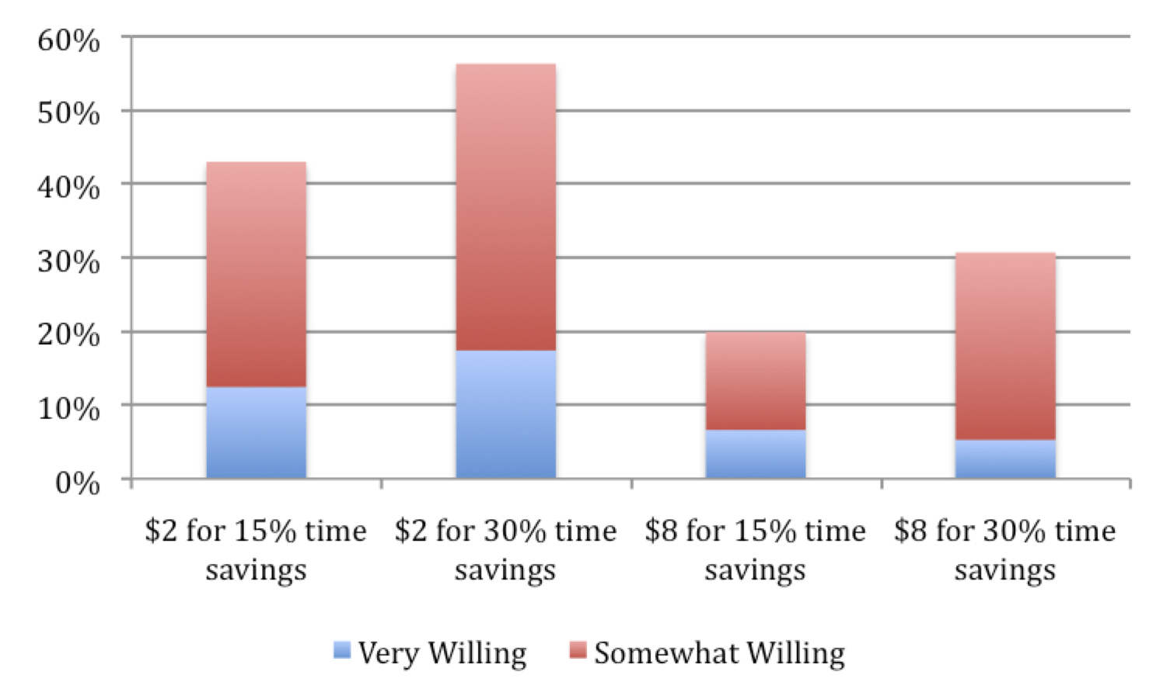
Paying to Save Time
Notes:
Our survey directly asked drivers if they would pay to reduce their commute. Drivers were randomly asked if they would pay either $2 or $8 to save reduce their commute times by either 15% or 30% - based on the average commute time of 43 minutes this correlates to saving 6.5 minutes or 13 minutes.

Slide 13
Revenue Tools
The Greater Toronto Area has among the worst traffic congestion in North America, with one of the longest commute times. The next few questions are about ways to reduce congestion in the GTA, including:
finding ways to fund the building of new, more efficient rapid transit options, and
improving road and highway travel.

Slide 14
User vs. Society Pays
63% of drivers surveyed supported user-based fees (transit fares, tolls, parking) to pay for transportation improvements as opposed to society-wide taxes (sales tax).

Slide 15
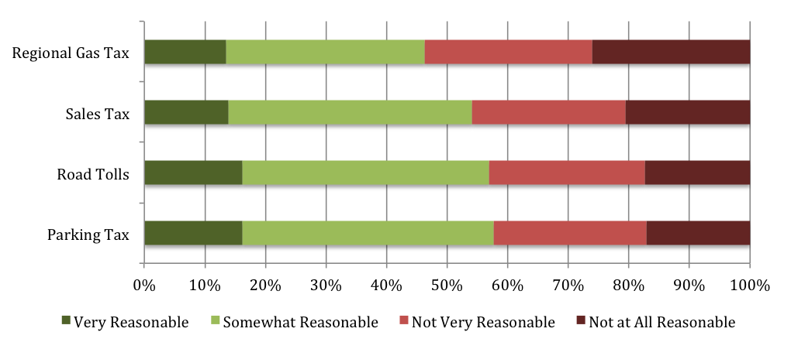
Drivers show moderate support for revenue tools to pay for transit expansion….

Slide 16
…with little variation in support between tools…
How reasonable are revenue tools to raise funds for transit expansion/ transportation improvements
58% thought tax on commercial parking lots was somewhat or very reasonable
57% percent thought a toll was somewhat or very reasonable
54% percent thought a 1% sales tax was somewhat or very reasonable

Slide 17
Revenue Tools (con’t)
46% percent percent of drivers thought a regional gas tax increase of 2 cents to fund transit build in the region was somewhat or very reasonable
54% percent of drivers who commute by major highway were likely to pay to use an optional express lane that would allow them to by-pass highway congestion (HOT lane)

Slide 18
Paying for Express
Notes:
72% of drivers would be somewhat willing to pay $2 to use an express lane; 53% would be willing to pay $5; 34% would be willing to pay $10. Given express lanes are not meant to be used by all drivers low-prices and high-willingness to use the lanes are not requirements. Route 91 in California for example charges up to $9.75 during the highest traffic periods. http://www.91expresslanes.com/schedules.asp

Slide 19
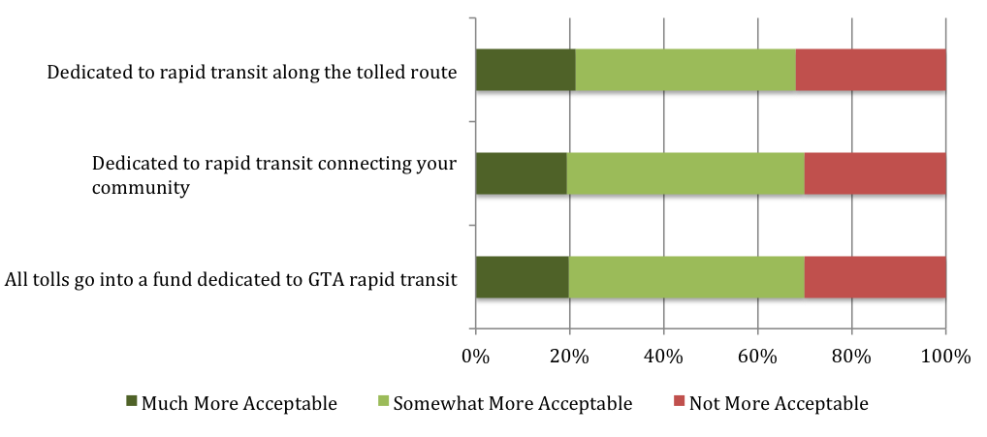
…but show higher support if funds are fair, transparent and dedicated
User fees are more acceptable if:

Slide 20
Transparency and dedication
69% of drivers are more willing to pay a user fee if it was dedicated to building new rapid transit that connected their community with a broader rapid transit system in the GTA

Slide 21
Transparency and dedication
69% would find a road toll more acceptable if they knew the funds were fully dedicated to building a rapid transit line close to this same route

Slide 22
Transparency and dedication
70% would be more willing to pay a new user fee if they could see the results in the form of new transit built in the GTA

Slide 23
Fairness
As for those who support a user-based road toll, most (68%) thought it should only be charged only on routes where drivers currently have access to rapid transit alternatives
For those who don’t, 46% thought them to be more acceptable if they were only on routes where rapid transit alternatives exist.
Notes:
Those in support of tolls – 57%/ those not 43%

Slide 24
Implementation and Acceptability
Stockholm: 30% support for road charging pre trial; 50% after trial; 70% after the reintroduction of the trial
Similar trend in Norway (toll) and London (cordon)
40% supported BC’s carbon tax in 2008 before it was introduced; November 2011 support rose to all time high 57%

Slide 25
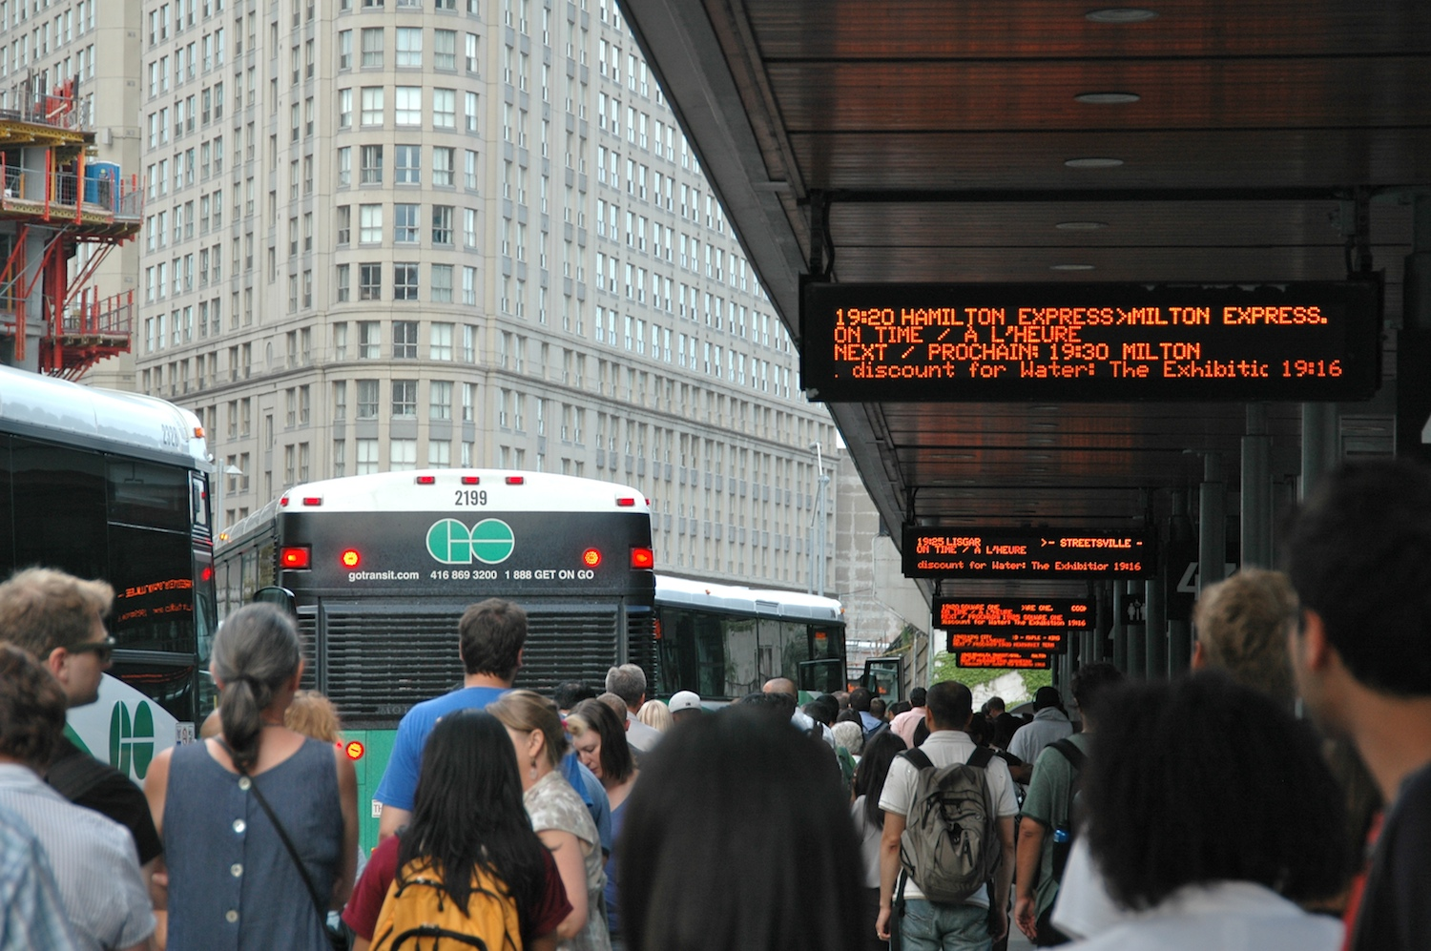
DETAILED FINDINGS

Slide 26
By Commute Stress

Slide 27
By Commute Stress

Slide 28
By Region
Toronto: 351
Peel Region: 241
Halton Region: 147
York Region: 166
Duram Region: 96

Slide 29
By Region

Slide 30
By Region

Slide 31
By Access to Rapid Transit

Slide 32
By Access to Rapid Transit

Slide 33
By Access to Rapid Transit

Slide 34
Conclusions
High interest in incentives and options
Not that much variation in support between pricing tools, but lowest support for gas tax
Higher support for user fees
Acceptability increases with dedication, transparency and fairness
Acceptability increases with implementation
Strong support for building transit
Education and understanding leads to greater acceptance

Slide 35
Policy Considerations
Not a matter of ‘if’ but when, where and how revenue tools are introduced; implement right and acceptability will follow
Consider combination of carrots and sticks; carrots can reduce congestion in the immediate term and sweeten the pot
High interest in PAYD worth considering a pilot
Education on the benefits is critical as well as clear understanding of the vision and transit technology
Dedication of revenue to transit expansion and benefits, with full transparency
Consider reframing how certain tools are named: regional gas tax vs. regional transit fee – and showing in real time where the funds are going/ getting close to the goal

Slide 36
Policy Considerations
Parking revenue tools are well supported, easy to implement and can happen without broad communications
Express lanes/HOT lanes could be piloted
Consider beginning with tolls or congestion charges along routes with available rapid transit
Ensure that tools are coordinated and collected strategically throughout the region and dedicated to priority projects eg: committing revenue to an expensive subway in low density area could preclude funding for more economically sound projects)
Education of society benefits society pays
Notes:
Express and HOT lanes could be a transitional policy between current ‘free’ highways and full tolls, and generate badly needed funds for transit infrastructure.

Slide 37
Key Messages
Congestion is causing stress and drivers want options
High interest in alternatives and options
Moderate support for revenue tools – Over 50% of drivers receptive to most pricing options
High support among drivers for revenue tools if it is dedicated to building rapid transit in the region (connecting with a network).
Strong interest in mode shifting to rapid transit if it was available

